Slide 1



Chapter 5 The LC-3
An Hong han@ustc.edu.cn
2018 Fall
Lecture on
Introduction to Computing Systems
（01170401）
School of Computer Science and Technology

Slide 2
Review: Von Neumann Model

Slide 3
Review: Instruction Processing（state transtion）
F
Fetch instruction from memory
D
Decode instruction
EA
Evaluate address
OP
Fetch operands from memory
EX
Execute operation
S
Store result
Notes:
3

Slide 4

Bottom up approach
Now, You are Here.
Transistor

Slide 5

Big Idea #2: How do we get the electrons to do the work?
Application
Algorithm & Data Structure
Language
Software
指令集体系结构 (Machine Architecture, ISA)
Hardware
Microarchiture
Now, You are Here.
Logic and IC
Device
Computer System: Layers of Abstraction
Notes:
5

Slide 6
Instruction Set Architecture
ISA = All of the programmer-visible components
and operations of the computer
  memory organization
    address space -- how may locations can be addressed?
    addressibility -- how many bits per location?
  register set
    how many? what size? how are they used?
  instruction set
    opcodes
    data types
    addressing modes
ISA provides all information needed for someone that wants to
write a program in machine language
(or translate from a high-level language to machine language).
Notes:
6

Slide 7
LC-3 Overview: Memory and Registers
Memory
  address space: 2¹⁶ locations(16-bit addresses)
  addressability: 16 bits
Registers
  temporary storage, accessed in a single machine cycle
    accessing memory generally takes longer than a single cycle
  eight general-purpose registers: R0 - R7
    each 16 bits wide
    how many bits to uniquely identify a register?
  other registers
    not directly addressable, but used by (and affected by) instructions
    PC (program counter), condition codes
Notes:
7

Slide 8
LC-3 Overview: Instruction Set
Opcodes
  15 opcodes
  Operate instructions: ADD, AND, NOT
  Data movement instructions: LD, LDI, LDR, LEA, ST, STR, STI
  Control instructions: BR, JSR/JSRR, JMP(RET), RTI, TRAP
  some opcodes(ADD, AND, NOT; LD, LDI, LDR, LEA) set/clear condition codes, based on result:
    N = negative, Z = zero, P = positive (> 0)
Data Types
  16-bit 2’s complement integer
Addressing Modes
  How is the location of an operand specified?
  non-memory addresses: immediate, register
  memory addresses: PC-relative, indirect, base+offset
Notes:
8

Slide 9
Operate Instructions
Only three operations: ADD, AND, NOT
Source and destination operands are registers
  These instructions do not reference memory.
  ADD and AND can use “immediate” mode,
  where one operand is hard-wired into the instruction.
Will show dataflow diagram with each instruction.
  illustrates when and where data moves to accomplish the desired operation
Notes:
9

Slide 10
LC-3 ISA Overview
_{运算指令(Operate Instructions)}
15
14
13
12
11
10
9
8
7
6
5
4
3
2
1
₀
数据移动指令
(Data Movement Instructions)
ADD
₀
₀
₀
1
DR
SR1
₀
₀
₀
SR2
ADD
₀
₀
₀
1
DR
SR1
1
_{Imm5}
取数指令(Load)
AND
₀
1
₀
1
DR
SR1
₀
₀
₀
SR2
AND
₀
1
₀
1
DR
SR1
1
Imm5
15
14
13
12
11
10
9
8
7
6
5
4
3
2
1
₀
LD
₀
₀
1
0
DR
_{PCoffset9}
NOT
1
₀
₀
1
DR
SR1
1
1
1
1
1
1
LDR
₀
₁
1
0
DR
BaseR
PCoffset6
Reserved
1
1
₀
1
LDI
₁
₀
1
0
DR
PCoffset9
控制指令(Control Instructions)
LEA
₁
₁
1
0
DR
PCoffset9
15
14
13
12
11
10
9
8
7
6
5
4
3
2
1
₀
存数指令(Store)
BR
₀
₀
0
0
n
z
_{p}
PCoffset9
JSR
₀
1
0
0
1
PCoffset11
15
14
13
12
11
10
9
8
7
6
5
4
3
2
1
₀
JSRR
₀
1
0
0
₀
₀
₀
BaseR
₀
₀
₀
₀
₀
₀
ST
₀
₀
1
1
SR
PCoffset9
RTI
1
₀
0
0
₀
₀
₀
₀
₀
₀
₀
₀
₀
₀
₀
₀
STR
₀
1
1
1
SR
_{BaseR}
PCoffset6
JMP
1
1
0
0
₀
₀
₀
BaseR
₀
₀
₀
₀
₀
₀
STI
1
₀
1
1
SR
PCoffset9
RET
1
1
0
0
₀
₀
₀
1
1
1
₀
₀
₀
₀
₀
₀
TRAP
1
1
1
1
₀
₀
₀
₀
TrapVector8

Slide 11
LC-3 Data Path
16
GatePC
16
GateMARMUX
LD.PC
PC
DR
3
MARMUX
+1
REG FILE
16
2
PCMUX
16
16
16
16
16
LD.REG
Control Unit
SR2
OUT
SR1
OUT
[7:0]
Processing Unit
SEXT
+
SR2
3
3
SR1
ADDR2MUX
MUX
MUX
ADDR1MUX
16
16
[10:0]
16
16
16
16
16
SEXT
[8:0]
LD.CC
16
SEXT
FINITE STATE MACHINE
SR2MUX
[5:0]
SEXT
16
N
Z
P
ALUK
A
B
[4:0]
SEXT
2
ALU
LD.IR
IR
LOGIC
…
16
16
16
RUN
GateALU
16
GateMDR
16
Memory Unit
LD.MDR
MDR
MEMORY
MAR
LD.MAR
16
INPUT
OUTPUT
MIO.EN
MUX
16
MEM.EN,R,W

Slide 12
LC-3 ISA Overview
_{运算指令}
15
14
13
12
11
10
9
8
7
6
5
4
3
2
1
₀
ADD
₀
₀
₀
1
DR
SR1
₀
₀
₀
SR2
移动数据指令
ADD
₀
₀
₀
1
DR
SR1
1
_{Imm5}
取数指令
AND
₀
1
₀
1
DR
SR1
₀
₀
₀
SR2
AND
₀
1
₀
1
DR
SR1
1
Imm5
15
14
13
12
11
10
9
8
7
6
5
4
3
2
1
₀
LD
₀
₀
1
0
DR
_{PCoffset9}
NOT
1
₀
₀
1
DR
SR1
1
1
1
1
1
1
LDR
₀
₁
1
0
DR
BaseR
PCoffset6
Reserved
1
1
₀
1
LDI
₁
₀
1
0
DR
PCoffset9
控制指令
LEA
₁
₁
1
0
DR
PCoffset9
15
14
13
12
11
10
9
8
7
6
5
4
3
2
1
₀
BR
₀
₀
0
0
n
z
_{p}
PCoffset9
存数指令
JSR
₀
1
0
0
1
PCoffset11
15
14
13
12
11
10
9
8
7
6
5
4
3
2
1
₀
JSRR
₀
1
0
0
₀
₀
₀
BaseR
₀
₀
₀
₀
₀
₀
ST
₀
₀
1
1
SR
PCoffset9
RTI
1
₀
0
0
₀
₀
₀
₀
₀
₀
₀
₀
₀
₀
₀
₀
STR
₀
1
1
1
SR
BaseR
PCoffset6
JMP
1
1
0
0
₀
₀
₀
BaseR
₀
₀
₀
₀
₀
₀
STI
1
₀
1
1
SR
PCoffset9
RET
1
1
0
0
₀
₀
₀
1
1
1
₀
₀
₀
₀
₀
₀
TRAP
1
1
1
1
₀
₀
₀
₀
TrapVector8

Slide 13
Operate Instructions
15
14
13
12
11
10
9
8
7
6
5
4
3
2
1
0
ADD
0
0
0
1
DR
SR1
0
0
0
SR2
ADD
0
0
0
1
DR
SR1
1
Imm5
AND
0
1
0
1
DR
SR1
0
0
0
SR2
AND
0
1
0
1
DR
SR1
1
Imm5
NOT
1
0
0
1
DR
SR1
1
1
1
1
1
1
Reserved
1
1
0
1

Slide 14
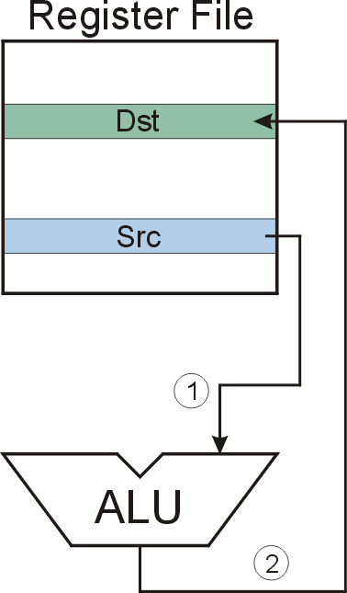
NOT (Register)
NOT
Note: Src and Dst
could be the same register.
Notes:
14

Slide 15
F
D
EA
NOT (Register):
OP
16
GatePC
16
GateMARMUX
EX
LD.PC
PC
DR
3
MARMUX
+1
REG FILE
16
2
PCMUX
16
16
16
16
16
LD.REG
S
[7:0]
SR2
SR2
OUT
SR1
OUT
SR1
SEXT
+
3
3
ADDR2MUX
MUX
MUX
ADDR1MUX
16
16
[10:0]
16
16
16
16
16
SEXT
[8:0]
LD.CC
16
SEXT
FINITE STATE MACHINE
SR2MUX
[5:0]
SEXT
16
N
Z
P
ALUK
A
B
[4:0]
SEXT
2
ALU
LD.IR
IR
LOGIC
…
16
16
16
RUN
GateALU
16
GateMDR
16
LD.MDR
MDR
MEMORY
MAR
LD.MAR
16
INPUT
OUTPUT
MIO.EN
MUX
16
MEM.EN,R,W

Slide 16
F
D
EA
NOT (Register):
OP
16
GatePC
16
GateMARMUX
EX
LD.PC
PC
DR
3
MARMUX
+1
REG FILE
16
2
PCMUX
16
16
16
16
16
LD.REG
S
[7:0]
SR2
SR2
OUT
SR1
OUT
SR1
SEXT
+
3
3
ADDR2MUX
MUX
MUX
ADDR1MUX
16
16
[10:0]
16
16
16
16
16
SEXT
[8:0]
LD.CC
16
SEXT
FINITE STATE MACHINE
SR2MUX
[5:0]
SEXT
16
N
Z
P
ALUK
A
B
[4:0]
SEXT
2
ALU
LD.IR
IR
LOGIC
…
16
16
16
RUN
GateALU
16
GateMDR
16
LD.MDR
MDR
MEMORY
MAR
LD.MAR
16
INPUT
OUTPUT
MIO.EN
MUX
16
MEM.EN,R,W

Slide 17
F
D
EA
NOT (Register):
OP
16
GatePC
16
GateMARMUX
EX
LD.PC
PC
DR
3
MARMUX
+1
REG FILE
16
2
PCMUX
16
16
16
16
16
LD.REG
S
[7:0]
SR2
SR2
OUT
SR1
OUT
SR1
SEXT
+
3
3
ADDR2MUX
MUX
MUX
ADDR1MUX
16
16
[10:0]
16
16
16
16
16
SEXT
[8:0]
LD.CC
16
SEXT
FINITE STATE MACHINE
SR2MUX
[5:0]
SEXT
16
N
Z
P
ALUK
A
B
[4:0]
SEXT
2
ALU
LD.IR
IR
LOGIC
…
16
16
16
RUN
GateALU
16
GateMDR
16
LD.MDR
MDR
MEMORY
MAR
LD.MAR
16
INPUT
OUTPUT
MIO.EN
MUX
16
MEM.EN,R,W

Slide 18
NOT (Register):
F
D
EA
OP
EX
S
16
GatePC
16
GateMARMUX
LD.PC
PC
DR
3
MARMUX
+1
REG FILE
16
2
PCMUX
16
16
16
16
16
LD.REG
[7:0]
SR2
SR2
OUT
SR1
OUT
SR1
SEXT
+
3
3
ADDR2MUX
MUX
MUX
ADDR1MUX
16
16
[10:0]
16
16
16
16
16
SEXT
[8:0]
LD.CC
16
SEXT
FINITE STATE MACHINE
SR2MUX
[5:0]
SEXT
16
N
Z
P
NOT
A
B
[4:0]
SEXT
2
ALU
LD.IR
IR
LOGIC
…
16
16
16
RUN
GateALU
16
GateMDR
16
LD.MDR
MDR
MEMORY
MAR
LD.MAR
16
INPUT
OUTPUT
MIO.EN
MUX
16
MEM.EN,R,W

Slide 19
NOT (Register): NOT R3, R5
Register File
R0
R1
R2
R3
0
1
0
1
0
0
0
0
1
1
1
1
0
0
0
0
R4
R5
1
0
1
0
1
1
1
1
0
0
0
0
1
1
1
1
R6
R7
①
②
A
B
ALU
NOT
Notes:
19

Slide 20
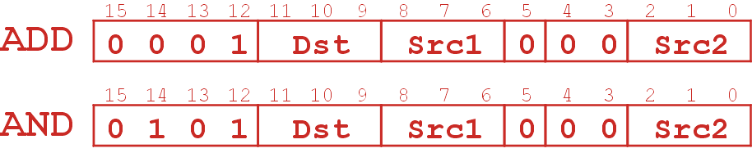
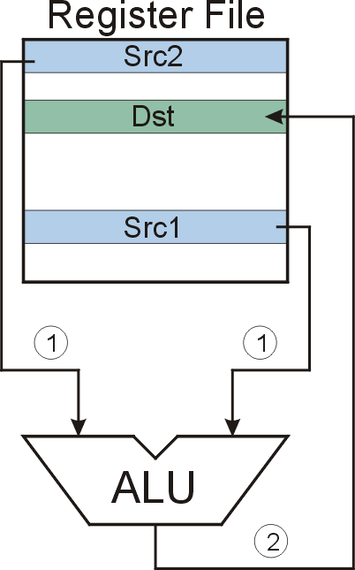
ADD/AND (Register)
this zero means “register mode”
ADD/AND
Notes:
20

Slide 21
F
D
EA
ADD/AND (Register)
OP
16
GatePC
16
GateMARMUX
EX
LD.PC
PC
DR
3
MARMUX
+1
REG FILE
16
2
PCMUX
16
16
16
16
16
LD.REG
S
[7:0]
SR2
SR2
OUT
SR1
OUT
SR1
SEXT
+
3
3
ADDR2MUX
MUX
MUX
ADDR1MUX
16
16
[10:0]
16
16
16
16
16
SEXT
[8:0]
LD.CC
16
SEXT
FINITE STATE MACHINE
SR2MUX
[5:0]
SEXT
16
N
Z
P
ALUK
A
B
[4:0]
SEXT
2
ALU
LD.IR
IR
LOGIC
…
16
16
16
RUN
GateALU
16
GateMDR
16
LD.MDR
MDR
MEMORY
MAR
LD.MAR
16
INPUT
OUTPUT
MIO.EN
MUX
16
MEM.EN,R,W

Slide 22
F
D
EA
ADD/AND (Register)
OP
16
GatePC
16
GateMARMUX
EX
LD.PC
PC
DR
3
MARMUX
+1
REG FILE
16
2
PCMUX
16
16
16
16
16
LD.REG
S
[7:0]
SR2
SR2
OUT
SR1
OUT
SR1
SEXT
+
3
3
ADDR2MUX
MUX
MUX
ADDR1MUX
16
16
[10:0]
16
16
16
16
16
SEXT
[8:0]
LD.CC
16
SEXT
FINITE STATE MACHINE
SR2MUX
[5:0]
SEXT
16
N
Z
P
ALUK
A
B
[4:0]
SEXT
2
ALU
LD.IR
IR
LOGIC
…
16
16
16
RUN
GateALU
16
GateMDR
16
LD.MDR
MDR
MEMORY
MAR
LD.MAR
16
INPUT
OUTPUT
MIO.EN
MUX
16
MEM.EN,R,W

Slide 23
F
D
EA
ADD/AND (Register)
OP
16
GatePC
16
GateMARMUX
EX
LD.PC
PC
DR
3
MARMUX
+1
REG FILE
16
2
PCMUX
16
16
16
16
16
LD.REG
S
[7:0]
SR2
SR2
OUT
SR1
OUT
SR1
SEXT
+
3
3
ADDR2MUX
MUX
MUX
ADDR1MUX
16
16
[10:0]
16
16
16
16
16
SEXT
[8:0]
LD.CC
16
SEXT
FINITE STATE MACHINE
SR2MUX
[5:0]
SEXT
16
N
Z
P
ALUK
A
B
[4:0]
SEXT
2
ALU
LD.IR
IR
LOGIC
…
16
16
16
RUN
GateALU
16
GateMDR
16
LD.MDR
MDR
MEMORY
MAR
LD.MAR
16
INPUT
OUTPUT
MIO.EN
MUX
16
MEM.EN,R,W

Slide 24
ADD/AND (Register)
F
D
EA
OP
EX
S
16
GatePC
16
GateMARMUX
LD.PC
PC
DR
3
MARMUX
+1
REG FILE
16
2
PCMUX
16
16
16
16
16
LD.REG
[7:0]
SR2
SR2
OUT
SR1
OUT
SR1
SEXT
+
3
3
ADDR2MUX
MUX
MUX
ADDR1MUX
16
16
[10:0]
16
16
16
16
16
SEXT
[8:0]
LD.CC
16
SEXT
FINITE STATE MACHINE
SR2MUX
[5:0]
SEXT
16
N
Z
P
ADD/AND
A
B
[4:0]
SEXT
2
ALU
LD.IR
IR
LOGIC
…
16
16
16
RUN
GateALU
16
GateMDR
16
LD.MDR
MDR
MEMORY
MAR
LD.MAR
16
INPUT
OUTPUT
MIO.EN
MUX
16
MEM.EN,R,W

Slide 25
AND (Register): AND R3, R5, R1
Register File
R0
R1
0
1
1
1
1
0
0
0
0
0
0
0
0
1
0
0
R2
IR
0
1
0
1
0
1
1
1
0
1
0
0
0
0
0
1
R3
0
0
1
0
1
0
0
0
0
0
0
0
0
1
0
0
R4
R5
1
0
1
0
1
1
1
1
0
0
0
0
1
1
1
1
R6
R7
①
①
②
Bit[5]= 0
1
0
A
B
ALU
AND
Notes:
25

Slide 26
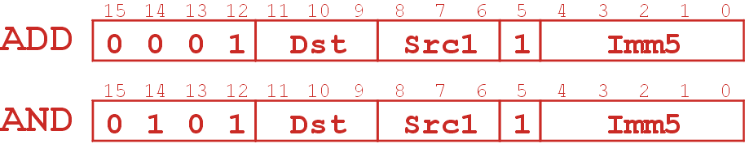
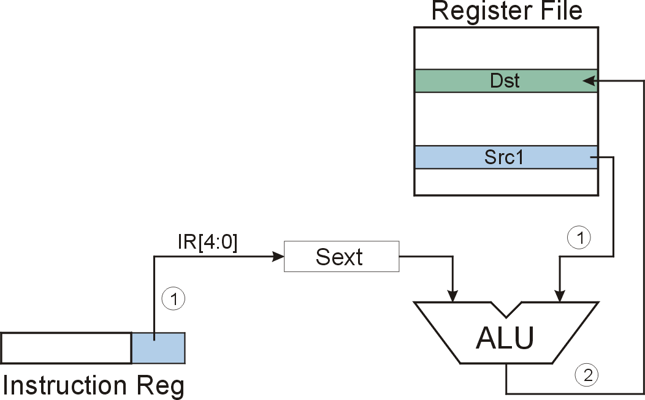
ADD/AND (Immediate)
this one means “immediate mode”
Note: Immediate field is
sign-extended.
ADD/AND
Notes:
26
.

Slide 27
F
D
EA
ADD/AND (Immediate)
OP
16
GatePC
16
GateMARMUX
EX
LD.PC
PC
DR
3
MARMUX
+1
REG FILE
16
2
PCMUX
16
16
16
16
16
LD.REG
S
[7:0]
SR2
SR2
OUT
SR1
OUT
SR1
SEXT
+
3
3
ADDR2MUX
MUX
MUX
ADDR1MUX
16
16
[10:0]
16
16
16
16
16
SEXT
[8:0]
LD.CC
16
SEXT
FINITE STATE MACHINE
SR2MUX
[5:0]
SEXT
16
N
Z
P
ALUK
A
B
[4:0]
SEXT
2
ALU
LD.IR
IR
LOGIC
…
16
16
16
RUN
GateALU
16
GateMDR
16
LD.MDR
MDR
MEMORY
MAR
LD.MAR
16
INPUT
OUTPUT
MIO.EN
MUX
16
MEM.EN,R,W

Slide 28
F
D
EA
ADD/AND (Immediate)
OP
16
GatePC
16
GateMARMUX
EX
LD.PC
PC
DR
3
MARMUX
+1
REG FILE
16
2
PCMUX
16
16
16
16
16
LD.REG
S
[7:0]
SR2
SR2
OUT
SR1
OUT
SR1
SEXT
+
3
3
ADDR2MUX
MUX
MUX
ADDR1MUX
16
16
[10:0]
16
16
16
16
16
SEXT
[8:0]
LD.CC
16
SEXT
FINITE STATE MACHINE
SR2MUX
[5:0]
SEXT
16
N
Z
P
ALUK
A
B
[4:0]
SEXT
2
ALU
LD.IR
IR
LOGIC
…
16
16
16
RUN
GateALU
16
GateMDR
16
LD.MDR
MDR
MEMORY
MAR
LD.MAR
16
INPUT
OUTPUT
MIO.EN
MUX
16
MEM.EN,R,W

Slide 29
F
D
EA
ADD/AND (Immediate)
OP
16
GatePC
16
GateMARMUX
EX
LD.PC
PC
DR
3
MARMUX
+1
REG FILE
16
2
PCMUX
16
16
16
16
16
LD.REG
S
[7:0]
SR2
SR2
OUT
SR1
OUT
SR1
SEXT
+
3
3
ADDR2MUX
MUX
MUX
ADDR1MUX
16
16
[10:0]
16
16
16
16
16
SEXT
[8:0]
LD.CC
16
SEXT
FINITE STATE MACHINE
SR2MUX
[5:0]
SEXT
16
N
Z
P
ALUK
A
B
[4:0]
SEXT
2
ALU
LD.IR
IR
LOGIC
…
16
16
16
RUN
GateALU
16
GateMDR
16
LD.MDR
MDR
MEMORY
MAR
LD.MAR
16
INPUT
OUTPUT
MIO.EN
MUX
16
MEM.EN,R,W

Slide 30
ADD/AND (Immediate)
F
D
EA
OP
EX
S
16
GatePC
16
GateMARMUX
LD.PC
PC
DR
3
MARMUX
+1
REG FILE
16
2
PCMUX
16
16
16
16
16
LD.REG
[7:0]
SR2
SR2
OUT
SR1
OUT
SR1
SEXT
+
3
3
ADDR2MUX
MUX
MUX
ADDR1MUX
16
16
[10:0]
16
16
16
16
16
SEXT
[8:0]
LD.CC
16
SEXT
FINITE STATE MACHINE
SR2MUX
[5:0]
SEXT
16
N
Z
P
ADD/AND
A
B
[4:0]
SEXT
2
ALU
LD.IR
IR
LOGIC
…
16
16
16
RUN
GateALU
16
GateMDR
16
LD.MDR
MDR
MEMORY
MAR
LD.MAR
16
INPUT
OUTPUT
MIO.EN
MUX
16
MEM.EN,R,W

Slide 31
ADD (Immediate) ADD R1, R5, #-2
Register File
R0
R1
0
0
0
0
0
0
0
0
0
0
0
0
0
1
0
0
R2
IR
0
0
0
1
0
0
1
1
0
1
1
1
1
1
1
0
R3
R4
IR[4:0]=11110
R5
0
0
0
0
0
0
0
0
0
0
0
0
0
1
1
0
R6
SEXT
R7
1111111111111110
①
①
②
1
0
Bit[5]=1
A
B
IR[4:0] = # -2
R5 = # 6
R1 = # 4
ALU
ADD
Notes:
31

Slide 32
Using Operate Instructions
With only ADD, AND, NOT…
  How do we subtract?
  How do we OR?
  How do we copy from one register to another?
  How do we initialize a register to zero?
Notes:
32
Subtract: R3 = R1 - R2
Take 2’s complement of R2, then add to R1.
(1) R2 = NOT(R2)
(2) R2 = R2 + 1
(3) R3 = R1 + R2
Register-to-register copy: R3 = R2
R3 = R2 + 0 (Add-immediate)
Initialize to zero: R1 = 0
R1 = R1 AND 0 (And-immediate)

Slide 33
LC-3 ISA Overview
_{运算指令}
15
14
13
12
11
10
9
8
7
6
5
4
3
2
1
₀
ADD
₀
₀
₀
1
DR
SR1
₀
₀
₀
SR2
移动数据指令
ADD
₀
₀
₀
1
DR
SR1
1
_{Imm5}
取数指令
AND
₀
1
₀
1
DR
SR1
₀
₀
₀
SR2
AND
₀
1
₀
1
DR
SR1
1
Imm5
15
14
13
12
11
10
9
8
7
6
5
4
3
2
1
₀
LD
₀
₀
1
0
DR
_{PCoffset9}
NOT
1
₀
₀
1
DR
SR1
1
1
1
1
1
1
LDR
₀
₁
1
0
DR
BaseR
PCoffset6
Reserved
1
1
₀
1
LDI
₁
₀
1
0
DR
PCoffset9
控制指令
LEA
₁
₁
1
0
DR
PCoffset9
15
14
13
12
11
10
9
8
7
6
5
4
3
2
1
₀
BR
₀
₀
0
0
n
z
_{p}
PCoffset9
存数指令
JSR
₀
1
0
0
1
PCoffset11
15
14
13
12
11
10
9
8
7
6
5
4
3
2
1
₀
JSRR
₀
1
0
0
₀
₀
₀
BaseR
₀
₀
₀
₀
₀
₀
ST
₀
₀
1
1
SR
PCoffset9
RTI
1
₀
0
0
₀
₀
₀
₀
₀
₀
₀
₀
₀
₀
₀
₀
STR
₀
1
1
1
SR
BaseR
PCoffset6
JMP
1
1
0
0
₀
₀
₀
BaseR
₀
₀
₀
₀
₀
₀
STI
1
₀
1
1
SR
PCoffset9
RET
1
1
0
0
₀
₀
₀
1
1
1
₀
₀
₀
₀
₀
₀
TRAP
1
1
1
1
₀
₀
₀
₀
TrapVector8

Slide 34
Data Movement Instructions
取数指令
15
14
13
12
11
10
9
8
7
6
5
4
3
2
1
0
LD
0
0
1
0
DR
PCoffset9
LDR
0
1
1
0
DR
BaseR
PCoffset6
LDI
1
0
1
0
DR
PCoffset9
LEA
1
1
1
0
DR
PCoffset9
存数指令
15
14
13
12
11
10
9
8
7
6
5
4
3
2
1
0
ST
0
0
1
1
SR
PCoffset9
STR
0
1
1
1
SR
BaseR
PCoffset6
STI
1
0
1
1
SR
PCoffset9

Slide 35
Data Movement Instructions
Load -- read data from memory to register
  LD: PC-relative mode
  LDR: base+offset mode
  LDI: indirect mode
Store -- write data from register to memory
  ST: PC-relative mode
  STR: base+offset mode
  STI: indirect mode
Load effective address -- compute address,
save in register
  LEA: immediate mode
  does not access memory
Notes:
35

Slide 36
PC-Relative Addressing Mode
Want to specify address directly in the instruction
  But an address is 16 bits, and so is an instruction!
  After subtracting 4 bits for opcode and 3 bits for register, we have 9 bits available for address.
Solution:
  Use the 9 bits as a signed offset from the current PC.
9 bits:
Can form any address X, such that:
Remember that PC is incremented as part of the FETCH phase;
This is done before the EVALUATE ADDRESS stage.

Slide 37
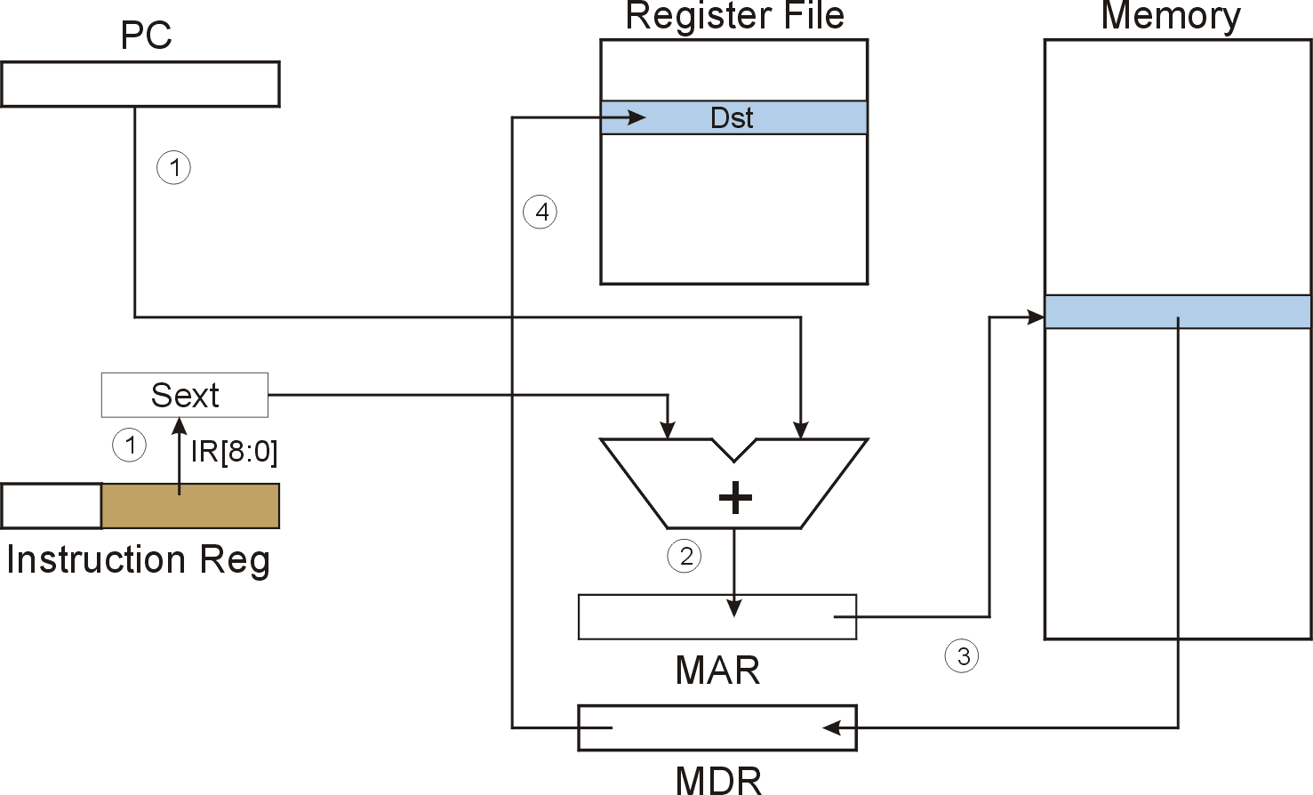
LD (PC-Relative) LD DR, PCoffset9
LD
Notes:
37

Slide 38
F
D
EA
LD (PC-Relative)
OP
16
GatePC
16
GateMARMUX
EX
LD.PC
PC
DR
3
MARMUX
+1
REG FILE
16
2
PCMUX
16
16
16
16
16
LD.REG
S
[7:0]
SR2
SR2
OUT
SR1
OUT
SR1
SEXT
+
3
3
ADDR2MUX
MUX
MUX
ADDR1MUX
16
16
[10:0]
16
16
16
16
16
SEXT
[8:0]
LD.CC
16
SEXT
FINITE STATE MACHINE
SR2MUX
[5:0]
SEXT
16
N
Z
P
ALUK
A
B
[4:0]
SEXT
2
ALU
LD.IR
IR
LOGIC
…
16
16
16
RUN
GateALU
16
GateMDR
16
LD.MDR
MDR
MEMORY
MAR
LD.MAR
16
INPUT
OUTPUT
MIO.EN
MUX
16
MEM.EN,R,W

Slide 39
F
D
EA
LD (PC-Relative)
OP
16
GatePC
16
GateMARMUX
EX
LD.PC
PC
DR
3
MARMUX
+1
REG FILE
16
2
PCMUX
16
16
16
16
16
LD.REG
S
[7:0]
SR2
SR2
OUT
SR1
OUT
SR1
SEXT
+
3
3
ADDR2MUX
MUX
MUX
ADDR1MUX
16
16
[10:0]
16
16
16
16
16
SEXT
[8:0]
LD.CC
16
SEXT
FINITE STATE MACHINE
SR2MUX
[5:0]
SEXT
16
N
Z
P
ALUK
A
B
[4:0]
SEXT
2
ALU
LD.IR
IR
LOGIC
…
16
16
16
RUN
GateALU
16
GateMDR
16
LD.MDR
MDR
MEMORY
MAR
LD.MAR
16
INPUT
OUTPUT
MIO.EN
MUX
16
MEM.EN,R,W

Slide 40
F
D
EA
LD (PC-Relative)
OP
16
GatePC
16
GateMARMUX
EX
LD.PC
PC
DR
3
MARMUX
+1
REG FILE
16
2
PCMUX
16
16
16
16
16
LD.REG
S
[7:0]
SR2
SR2
OUT
SR1
OUT
SR1
SEXT
+
3
3
ADDR2MUX
MUX
MUX
ADDR1MUX
16
16
[10:0]
16
16
16
16
16
SEXT
[8:0]
LD.CC
16
SEXT
FINITE STATE MACHINE
SR2MUX
[5:0]
SEXT
16
N
Z
P
ALUK
A
B
[4:0]
SEXT
2
ALU
LD.IR
IR
LOGIC
…
16
16
16
RUN
GateALU
16
GateMDR
16
LD.MDR
MDR
MEMORY
MAR
LD.MAR
16
INPUT
OUTPUT
MIO.EN
MUX
16
MEM.EN,R,W

Slide 41
LD (PC-Relative)
F
D
EA
OP
EX
S
16
GatePC
16
GateMARMUX
LD.PC
PC
DR
3
MARMUX
+1
REG FILE
16
2
PCMUX
16
16
16
16
16
LD.REG
[7:0]
SR2
SR2
OUT
SR1
OUT
SR1
SEXT
+
3
3
ADDR2MUX
MUX
MUX
ADDR1MUX
16
16
[10:0]
16
16
16
16
16
SEXT
[8:0]
LD.CC
16
SEXT
FINITE STATE MACHINE
SR2MUX
[5:0]
SEXT
16
N
Z
P
ALUK
A
B
[4:0]
SEXT
2
ALU
LD.IR
IR
LOGIC
…
16
16
16
RUN
GateALU
16
GateMDR
16
LD.MDR
MDR
MEMORY
MAR
LD.MAR
16
INPUT
OUTPUT
MIO.EN
MUX
16
MEM.EN,R,W

Slide 42
D
EA
LD (PC-Relative)
F
OP
16
GatePC
16
GateMARMUX
EX
LD.PC
PC
DR
3
MARMUX
+1
REG FILE
16
2
PCMUX
16
16
16
16
16
LD.REG
S
[7:0]
SR2
SR2
OUT
SR1
OUT
SR1
SEXT
+
3
3
ADDR2MUX
MUX
MUX
ADDR1MUX
16
16
[10:0]
16
16
16
16
16
SEXT
[8:0]
LD.CC
16
SEXT
FINITE STATE MACHINE
SR2MUX
[5:0]
SEXT
16
N
Z
P
ALUK
A
B
[4:0]
SEXT
2
ALU
LD.IR
IR
LOGIC
…
16
16
16
RUN
GateALU
16
GateMDR
16
LD.MDR
MDR
MEMORY
MAR
LD.MAR
16
INPUT
OUTPUT
MIO.EN
MUX
16
MEM.EN,R,W

Slide 43
D
EA
LD (PC-Relative)
F
EX
OP
16
GatePC
16
GateMARMUX
LD.PC
PC
DR
3
MARMUX
+1
REG FILE
16
2
PCMUX
16
16
16
16
16
LD.REG
S
[7:0]
SR2
SR2
OUT
SR1
OUT
SR1
SEXT
+
3
3
ADDR2MUX
MUX
MUX
ADDR1MUX
16
16
[10:0]
16
16
16
16
16
SEXT
[8:0]
LD.CC
16
SEXT
FINITE STATE MACHINE
SR2MUX
[5:0]
SEXT
16
N
Z
P
ALUK
A
B
[4:0]
SEXT
2
ALU
LD.IR
IR
LOGIC
…
16
16
16
GateALU
RUN
16
GateMDR
16
LD.MDR
MDR
MEMORY
MAR
LD.MAR
16
INPUT
OUTPUT
MIO.EN
MUX
16
MEM.EN,R,W

Slide 44
LD (PC-Relative) : LD R1, x1AF
Register File
Memory
PC
0
1
0
0
0
0
0
0
0
0
0
1
1
0
0
1
R0
R1
0
0
0
0
0
0
0
0
0
0
0
0
0
1
0
1
R2
IR
0
0
1
0
0
0
1
1
1
0
1
0
1
1
1
1
R3
①
①
R4
IR[8:0]=110101111
R5
SEXT
R6
x3FC8
R7
0
0
0
0
0
0
0
0
0
0
0
0
0
1
0
1
1111111110101111 = xFFAF
x4019
A
B
+
PC = x4018
PC+1 = x4019
X4019 + xFFAF = x3FC8
②
④
③
x3FC8
x3FC8
MAR
③
# 5
MDR
Notes:
44

Slide 45
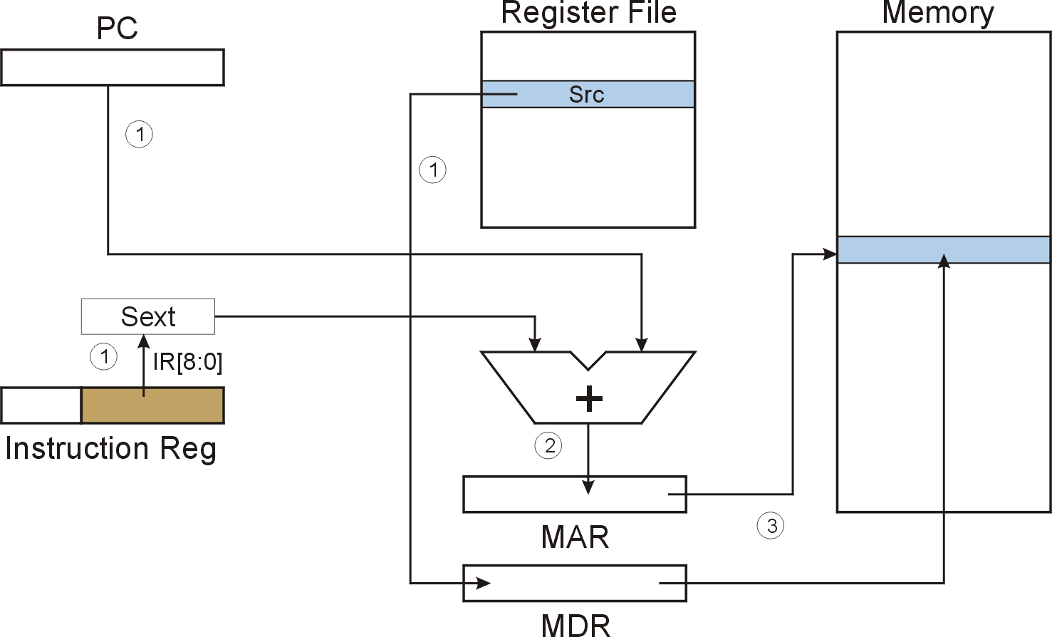
ST (PC-Relative) ST DR, PCoffset9
4
ST
Notes:
45

Slide 46
F
D
EA
ST (PC-Relative)
OP
16
GatePC
16
GateMARMUX
EX
LD.PC
PC
DR
3
MARMUX
+1
REG FILE
16
2
PCMUX
16
16
16
16
16
LD.REG
S
[7:0]
SR2
SR2
OUT
SR1
OUT
SR1
SEXT
+
3
3
ADDR2MUX
MUX
MUX
ADDR1MUX
16
16
[10:0]
16
16
16
16
16
SEXT
[8:0]
LD.CC
16
SEXT
FINITE STATE MACHINE
SR2MUX
[5:0]
SEXT
16
N
Z
P
ALUK
A
B
[4:0]
SEXT
2
ALU
LD.IR
IR
LOGIC
…
16
16
16
RUN
GateALU
16
GateMDR
16
LD.MDR
MDR
MEMORY
MAR
LD.MAR
16
INPUT
OUTPUT
MIO.EN
MUX
16
MEM.EN,R,W

Slide 47
F
D
EA
ST (PC-Relative)
OP
16
GatePC
16
GateMARMUX
EX
LD.PC
PC
DR
3
MARMUX
+1
REG FILE
16
2
PCMUX
16
16
16
16
16
LD.REG
S
[7:0]
SR2
SR2
OUT
SR1
OUT
SR1
SEXT
+
3
3
ADDR2MUX
MUX
MUX
ADDR1MUX
16
16
[10:0]
16
16
16
16
16
SEXT
[8:0]
LD.CC
16
SEXT
FINITE STATE MACHINE
SR2MUX
[5:0]
SEXT
16
N
Z
P
ALUK
A
B
[4:0]
SEXT
2
ALU
LD.IR
IR
LOGIC
…
16
16
16
RUN
GateALU
16
GateMDR
16
LD.MDR
MDR
MEMORY
MAR
LD.MAR
16
INPUT
OUTPUT
MIO.EN
MUX
16
MEM.EN,R,W

Slide 48
F
D
EA
ST (PC-Relative)
OP
16
GatePC
16
GateMARMUX
EX
LD.PC
PC
DR
3
MARMUX
+1
REG FILE
16
2
PCMUX
16
16
16
16
16
LD.REG
S
[7:0]
SR2
SR2
OUT
SR1
OUT
SR1
SEXT
+
3
3
ADDR2MUX
MUX
MUX
ADDR1MUX
16
16
[10:0]
16
16
16
16
16
SEXT
[8:0]
LD.CC
16
SEXT
FINITE STATE MACHINE
SR2MUX
[5:0]
SEXT
16
N
Z
P
ALUK
A
B
[4:0]
SEXT
2
ALU
LD.IR
IR
LOGIC
…
16
16
16
RUN
GateALU
16
GateMDR
16
LD.MDR
MDR
MEMORY
MAR
LD.MAR
16
INPUT
OUTPUT
MIO.EN
MUX
16
MEM.EN,R,W

Slide 49
ST (PC-Relative)
F
D
EA
OP
EX
S
16
GatePC
16
GateMARMUX
LD.PC
PC
DR
3
MARMUX
+1
REG FILE
16
2
PCMUX
16
16
16
16
16
LD.REG
[7:0]
SR2
SR2
OUT
SR1
OUT
SR1
SEXT
+
3
3
ADDR2MUX
MUX
MUX
ADDR1MUX
16
16
[10:0]
16
16
16
16
16
SEXT
[8:0]
LD.CC
16
SEXT
FINITE STATE MACHINE
SR2MUX
[5:0]
SEXT
16
N
Z
P
ALUK
A
B
[4:0]
SEXT
2
ALU
LD.IR
IR
LOGIC
…
16
16
16
RUN
GateALU
16
GateMDR
16
LD.MDR
MDR
MEMORY
MAR
LD.MAR
16
INPUT
OUTPUT
MIO.EN
MUX
16
MEM.EN,R,W

Slide 50
D
EA
ST (PC-Relative)
F
EX
S
OP
16
GatePC
16
GateMARMUX
LD.PC
PC
DR
3
MARMUX
+1
REG FILE
16
2
PCMUX
16
16
16
16
16
LD.REG
[7:0]
SR2
SR2
OUT
SR1
OUT
SR1
SEXT
+
3
3
ADDR2MUX
MUX
MUX
ADDR1MUX
16
16
[10:0]
16
16
16
16
16
SEXT
[8:0]
LD.CC
16
SEXT
FINITE STATE MACHINE
SR2MUX
[5:0]
SEXT
16
N
Z
P
ALUK
A
B
[4:0]
SEXT
2
ALU
LD.IR
IR
LOGIC
…
16
16
16
GateALU
RUN
16
GateMDR
16
LD.MDR
MDR
MEMORY
MAR
LD.MAR
16
INPUT
OUTPUT
MIO.EN
MUX
16
MEM.EN,R,W

Slide 51
D
EA
ST (PC-Relative)
F
EX
OP
16
GatePC
16
GateMARMUX
LD.PC
PC
DR
3
MARMUX
+1
REG FILE
16
2
PCMUX
16
16
16
16
16
LD.REG
S
[7:0]
SR2
SR2
OUT
SR1
OUT
SR1
SEXT
+
3
3
ADDR2MUX
MUX
MUX
ADDR1MUX
16
16
[10:0]
16
16
16
16
16
SEXT
[8:0]
LD.CC
16
SEXT
FINITE STATE MACHINE
SR2MUX
[5:0]
SEXT
16
N
Z
P
ALUK
A
B
[4:0]
SEXT
2
ALU
LD.IR
IR
LOGIC
…
16
16
16
RUN
GateALU
16
GateMDR
16
LD.MDR
MDR
MEMORY
MAR
LD.MAR
16
INPUT
OUTPUT
MIO.EN
MUX
16
MEM.EN,R,W

Slide 52
Indirect Addressing Mode
With PC-relative mode, can only address data
within 256 words of the instruction.
  What about the rest of memory?
Solution #1:
  Read address from memory location,
  then load/store to that address.
First address is generated from PC and IR
(just like PC-relative addressing), then
content of that address is used as target for load/store.

Slide 53
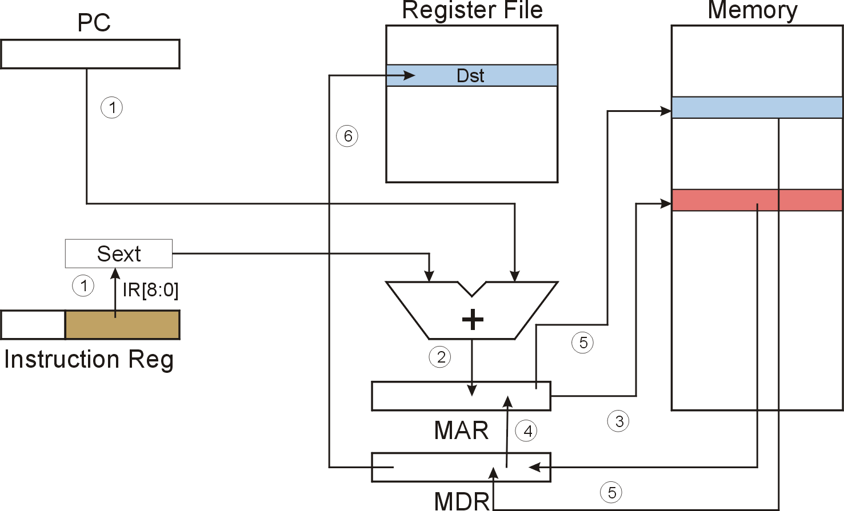
LDI (Indirect) LDI DR, PCoffset9
LDI
Notes:
53

Slide 54
F
D
EA
LDI (Indirect)
OP
16
GatePC
16
GateMARMUX
EX
LD.PC
PC
DR
3
MARMUX
+1
REG FILE
16
2
PCMUX
16
16
16
16
16
LD.REG
S
[7:0]
SR2
SR2
OUT
SR1
OUT
SR1
SEXT
+
3
3
ADDR2MUX
MUX
MUX
ADDR1MUX
16
16
[10:0]
16
16
16
16
16
SEXT
[8:0]
LD.CC
16
SEXT
FINITE STATE MACHINE
SR2MUX
[5:0]
SEXT
16
N
Z
P
ALUK
A
B
[4:0]
SEXT
2
ALU
LD.IR
IR
LOGIC
…
16
16
16
RUN
GateALU
16
GateMDR
16
LD.MDR
MDR
MEMORY
MAR
LD.MAR
16
INPUT
OUTPUT
MIO.EN
MUX
16
MEM.EN,R,W

Slide 55
F
D
EA
LDI (Indirect)
OP
16
GatePC
16
GateMARMUX
EX
LD.PC
PC
DR
3
MARMUX
+1
REG FILE
16
2
PCMUX
16
16
16
16
16
LD.REG
S
[7:0]
SR2
SR2
OUT
SR1
OUT
SR1
SEXT
+
3
3
ADDR2MUX
MUX
MUX
ADDR1MUX
16
16
[10:0]
16
16
16
16
16
SEXT
[8:0]
LD.CC
16
SEXT
FINITE STATE MACHINE
SR2MUX
[5:0]
SEXT
16
N
Z
P
ALUK
A
B
[4:0]
SEXT
2
ALU
LD.IR
IR
LOGIC
…
16
16
16
RUN
GateALU
16
GateMDR
16
LD.MDR
MDR
MEMORY
MAR
LD.MAR
16
INPUT
OUTPUT
MIO.EN
MUX
16
MEM.EN,R,W

Slide 56
F
D
EA
LDI (Indirect)
OP
16
GatePC
16
GateMARMUX
EX
LD.PC
PC
DR
3
MARMUX
+1
REG FILE
16
2
PCMUX
16
16
16
16
16
LD.REG
S
[7:0]
SR2
SR2
OUT
SR1
OUT
SR1
SEXT
+
3
3
ADDR2MUX
MUX
MUX
ADDR1MUX
16
16
[10:0]
16
16
16
16
16
SEXT
[8:0]
LD.CC
16
SEXT
FINITE STATE MACHINE
SR2MUX
[5:0]
SEXT
16
N
Z
P
ALUK
A
B
[4:0]
SEXT
2
ALU
LD.IR
IR
LOGIC
…
16
16
16
RUN
GateALU
16
GateMDR
16
LD.MDR
MDR
MEMORY
MAR
LD.MAR
16
INPUT
OUTPUT
MIO.EN
MUX
16
MEM.EN,R,W

Slide 57
LDI (Indirect)
F
D
EA
OP
EX
S
16
GatePC
16
GateMARMUX
LD.PC
PC
DR
3
MARMUX
+1
REG FILE
16
2
PCMUX
16
16
16
16
16
LD.REG
[7:0]
SR2
SR2
OUT
SR1
OUT
SR1
SEXT
+
3
3
ADDR2MUX
MUX
MUX
ADDR1MUX
16
16
[10:0]
16
16
16
16
16
SEXT
[8:0]
LD.CC
16
SEXT
FINITE STATE MACHINE
SR2MUX
[5:0]
SEXT
16
N
Z
P
ALUK
A
B
[4:0]
SEXT
2
ALU
LD.IR
IR
LOGIC
…
16
16
16
RUN
GateALU
16
GateMDR
16
LD.MDR
MDR
MEMORY
MAR
LD.MAR
16
INPUT
OUTPUT
MIO.EN
MUX
16
MEM.EN,R,W

Slide 58
D
LDI (Indirect)
F
EA
OP
16
GatePC
16
GateMARMUX
EX
LD.PC
PC
DR
3
MARMUX
+1
REG FILE
16
2
PCMUX
16
16
16
16
16
LD.REG
S
[7:0]
SR2
SR2
OUT
SR1
OUT
SR1
SEXT
+
3
3
ADDR2MUX
MUX
MUX
ADDR1MUX
16
16
[10:0]
16
16
16
16
16
SEXT
[8:0]
LD.CC
16
SEXT
FINITE STATE MACHINE
SR2MUX
[5:0]
SEXT
16
N
Z
P
ALUK
A
B
[4:0]
SEXT
2
ALU
LD.IR
IR
LOGIC
…
16
16
16
RUN
GateALU
16
GateMDR
16
LD.MDR
MDR
MEMORY
MAR
LD.MAR
16
INPUT
OUTPUT
MIO.EN
MUX
16
MEM.EN,R,W

Slide 59
D
EA
LDI (Indirect)
F
OP
16
GatePC
16
GateMARMUX
EX
LD.PC
PC
DR
3
MARMUX
+1
REG FILE
16
2
PCMUX
16
16
16
16
16
LD.REG
S
[7:0]
SR2
SR2
OUT
SR1
OUT
SR1
SEXT
+
3
3
ADDR2MUX
MUX
MUX
ADDR1MUX
16
16
[10:0]
16
16
16
16
16
SEXT
[8:0]
LD.CC
16
SEXT
FINITE STATE MACHINE
SR2MUX
[5:0]
SEXT
16
N
Z
P
ALUK
A
B
[4:0]
SEXT
2
ALU
LD.IR
IR
LOGIC
…
16
16
16
RUN
GateALU
16
GateMDR
16
LD.MDR
MDR
MEMORY
MAR
LD.MAR
16
INPUT
OUTPUT
MIO.EN
MUX
16
MEM.EN,R,W

Slide 60
D
LDI (Indirect)
F
EA
OP
16
GatePC
16
GateMARMUX
EX
LD.PC
PC
DR
3
MARMUX
+1
REG FILE
16
2
PCMUX
16
16
16
16
16
LD.REG
S
[7:0]
SR2
SR2
OUT
SR1
OUT
SR1
SEXT
+
3
3
ADDR2MUX
MUX
MUX
ADDR1MUX
16
16
[10:0]
16
16
16
16
16
SEXT
[8:0]
LD.CC
16
SEXT
FINITE STATE MACHINE
SR2MUX
[5:0]
SEXT
16
N
Z
P
ALUK
A
B
[4:0]
SEXT
2
ALU
LD.IR
IR
LOGIC
…
16
16
16
RUN
GateALU
16
GateMDR
16
LD.MDR
MDR
MEMORY
MAR
LD.MAR
16
INPUT
OUTPUT
MIO.EN
MUX
16
MEM.EN,R,W

Slide 61
D
EA
LDI (Indirect)
F
EX
OP
16
GatePC
16
GateMARMUX
LD.PC
PC
DR
3
MARMUX
+1
REG FILE
16
2
PCMUX
16
16
16
16
16
LD.REG
S
[7:0]
SR2
SR2
OUT
SR1
OUT
SR1
SEXT
+
3
3
ADDR2MUX
MUX
MUX
ADDR1MUX
16
16
[10:0]
16
16
16
16
16
SEXT
[8:0]
LD.CC
16
SEXT
FINITE STATE MACHINE
SR2MUX
[5:0]
SEXT
16
N
Z
P
ALUK
A
B
[4:0]
SEXT
2
ALU
LD.IR
IR
LOGIC
…
16
16
16
GateALU
RUN
16
GateMDR
16
LD.MDR
MDR
MEMORY
MAR
LD.MAR
16
INPUT
OUTPUT
MIO.EN
MUX
16
MEM.EN,R,W

Slide 62
LDI (Indirect) : LDI R1, x1AF
Register File
Memory
PC
0
1
0
0
0
0
0
0
0
0
0
1
1
0
0
1
R0
R1
1
1
1
1
1
1
1
1
1
1
1
1
1
1
1
1
R2
IR
1
0
1
0
0
0
1
1
1
0
1
0
1
1
1
1
R3
x2100
1
1
1
1
1
1
1
1
1
1
1
1
1
1
1
1
①
①
R4
IR[8:0]=110101111
R5
SEXT
R6
x3FC8
R7
0
0
1
0
0
0
0
1
0
0
0
0
0
0
0
0
1111111110101111 = xFFAF
x4019
A
B
+
PC = x4018
PC+1 = x4019
X4019 + xFFAF = x3FC8
②
④
③
x3FC8
x3FC8/ x2100
MAR
③
x2100/ # -1
MDR
Notes:
62

Slide 63
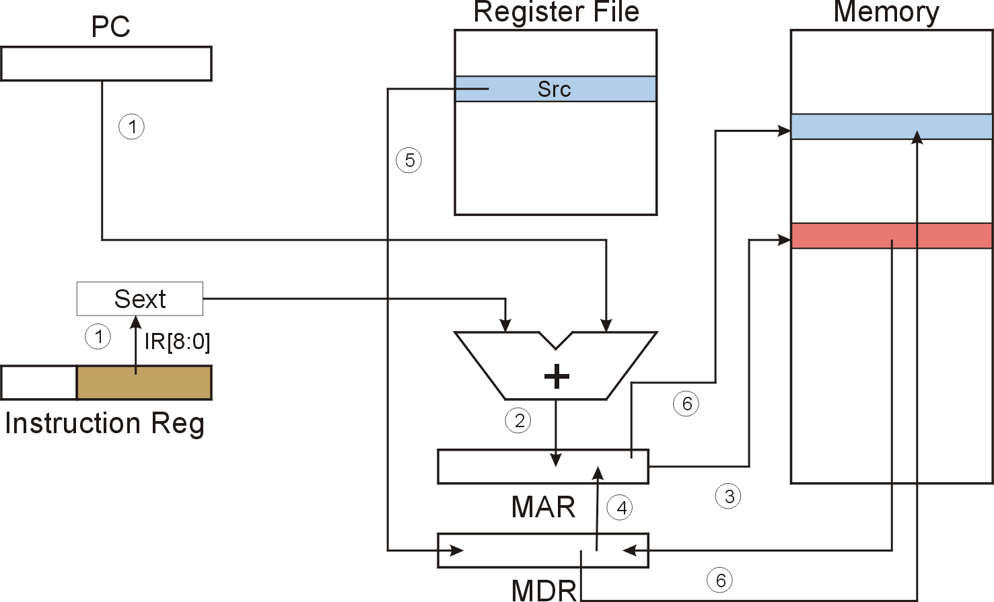
STI (Indirect) STI DR, PCoffset9
STI
Notes:
63

Slide 64
F
D
EA
STI (Indirect)
OP
16
GatePC
16
GateMARMUX
EX
LD.PC
PC
DR
3
MARMUX
+1
REG FILE
16
2
PCMUX
16
16
16
16
16
LD.REG
S
[7:0]
SR2
SR2
OUT
SR1
OUT
SR1
SEXT
+
3
3
ADDR2MUX
MUX
MUX
ADDR1MUX
16
16
[10:0]
16
16
16
16
16
SEXT
[8:0]
LD.CC
16
SEXT
FINITE STATE MACHINE
SR2MUX
[5:0]
SEXT
16
N
Z
P
ALUK
A
B
[4:0]
SEXT
2
ALU
LD.IR
IR
LOGIC
…
16
16
16
RUN
GateALU
16
GateMDR
16
LD.MDR
MDR
MEMORY
MAR
LD.MAR
16
INPUT
OUTPUT
MIO.EN
MUX
16
MEM.EN,R,W

Slide 65
F
D
EA
STI (Indirect)
OP
16
GatePC
16
GateMARMUX
EX
LD.PC
PC
DR
3
MARMUX
+1
REG FILE
16
2
PCMUX
16
16
16
16
16
LD.REG
S
[7:0]
SR2
SR2
OUT
SR1
OUT
SR1
SEXT
+
3
3
ADDR2MUX
MUX
MUX
ADDR1MUX
16
16
[10:0]
16
16
16
16
16
SEXT
[8:0]
LD.CC
16
SEXT
FINITE STATE MACHINE
SR2MUX
[5:0]
SEXT
16
N
Z
P
ALUK
A
B
[4:0]
SEXT
2
ALU
LD.IR
IR
LOGIC
…
16
16
16
RUN
GateALU
16
GateMDR
16
LD.MDR
MDR
MEMORY
MAR
LD.MAR
16
INPUT
OUTPUT
MIO.EN
MUX
16
MEM.EN,R,W

Slide 66
F
D
EA
STI (Indirect)
OP
16
GatePC
16
GateMARMUX
EX
LD.PC
PC
DR
3
MARMUX
+1
REG FILE
16
2
PCMUX
16
16
16
16
16
LD.REG
S
[7:0]
SR2
SR2
OUT
SR1
OUT
SR1
SEXT
+
3
3
ADDR2MUX
MUX
MUX
ADDR1MUX
16
16
[10:0]
16
16
16
16
16
SEXT
[8:0]
LD.CC
16
SEXT
FINITE STATE MACHINE
SR2MUX
[5:0]
SEXT
16
N
Z
P
ALUK
A
B
[4:0]
SEXT
2
ALU
LD.IR
IR
LOGIC
…
16
16
16
RUN
GateALU
16
GateMDR
16
LD.MDR
MDR
MEMORY
MAR
LD.MAR
16
INPUT
OUTPUT
MIO.EN
MUX
16
MEM.EN,R,W

Slide 67
STI (Indirect)
F
D
EA
OP
EX
S
16
GatePC
16
GateMARMUX
LD.PC
PC
DR
3
MARMUX
+1
REG FILE
16
2
PCMUX
16
16
16
16
16
LD.REG
[7:0]
SR2
SR2
OUT
SR1
OUT
SR1
SEXT
+
3
3
ADDR2MUX
MUX
MUX
ADDR1MUX
16
16
[10:0]
16
16
16
16
16
SEXT
[8:0]
LD.CC
16
SEXT
FINITE STATE MACHINE
SR2MUX
[5:0]
SEXT
16
N
Z
P
ALUK
A
B
[4:0]
SEXT
2
ALU
LD.IR
IR
LOGIC
…
16
16
16
RUN
GateALU
16
GateMDR
16
LD.MDR
MDR
MEMORY
MAR
LD.MAR
16
INPUT
OUTPUT
MIO.EN
MUX
16
MEM.EN,R,W

Slide 68
D
EA
STI (Indirect)
F
OP
16
GatePC
16
GateMARMUX
EX
LD.PC
PC
DR
3
MARMUX
+1
REG FILE
16
2
PCMUX
16
16
16
16
16
LD.REG
S
[7:0]
SR2
SR2
OUT
SR1
OUT
SR1
SEXT
+
3
3
ADDR2MUX
MUX
MUX
ADDR1MUX
16
16
[10:0]
16
16
16
16
16
SEXT
[8:0]
LD.CC
16
SEXT
FINITE STATE MACHINE
SR2MUX
[5:0]
SEXT
16
N
Z
P
ALUK
A
B
[4:0]
SEXT
2
ALU
LD.IR
IR
LOGIC
…
16
16
16
RUN
GateALU
16
GateMDR
16
LD.MDR
MDR
MEMORY
MAR
LD.MAR
16
INPUT
OUTPUT
MIO.EN
MUX
16
MEM.EN,R,W

Slide 69
D
EA
STI (Indirect)
F
OP
16
GatePC
16
GateMARMUX
EX
LD.PC
PC
DR
3
MARMUX
+1
REG FILE
16
2
PCMUX
16
16
16
16
16
LD.REG
S
[7:0]
SR2
SR2
OUT
SR1
OUT
SR1
SEXT
+
3
3
ADDR2MUX
MUX
MUX
ADDR1MUX
16
16
[10:0]
16
16
16
16
16
SEXT
[8:0]
LD.CC
16
SEXT
FINITE STATE MACHINE
SR2MUX
[5:0]
SEXT
16
N
Z
P
ALUK
A
B
[4:0]
SEXT
2
ALU
LD.IR
IR
LOGIC
…
16
16
16
RUN
GateALU
16
GateMDR
16
LD.MDR
MDR
MEMORY
MAR
LD.MAR
16
INPUT
OUTPUT
MIO.EN
MUX
16
MEM.EN,R,W

Slide 70
D
EA
STI (Indirect)
F
EX
OP
OP
16
GatePC
16
GateMARMUX
LD.PC
PC
DR
3
MARMUX
+1
REG FILE
16
2
PCMUX
16
16
16
16
16
LD.REG
[7:0]
SR2
SR2
OUT
SR1
OUT
SR1
SEXT
+
3
3
ADDR2MUX
MUX
MUX
ADDR1MUX
16
16
[10:0]
16
16
16
16
16
SEXT
[8:0]
LD.CC
16
SEXT
FINITE STATE MACHINE
SR2MUX
[5:0]
SEXT
16
N
Z
P
ALUK
A
B
[4:0]
SEXT
2
ALU
LD.IR
IR
LOGIC
…
16
16
16
GateALU
RUN
16
GateMDR
16
LD.MDR
MDR
MEMORY
MAR
LD.MAR
16
INPUT
OUTPUT
MIO.EN
MUX
16
MEM.EN,R,W

Slide 71
D
EA
STI (Indirect)
F
OP
EX
S
16
GatePC
16
GateMARMUX
LD.PC
PC
DR
3
MARMUX
+1
REG FILE
16
2
PCMUX
16
16
16
16
16
LD.REG
[7:0]
SR2
SR2
OUT
SR1
OUT
SR1
SEXT
+
3
3
ADDR2MUX
MUX
MUX
ADDR1MUX
16
16
[10:0]
16
16
16
16
16
SEXT
[8:0]
LD.CC
16
SEXT
FINITE STATE MACHINE
SR2MUX
[5:0]
SEXT
16
N
Z
P
ALUK
A
B
[4:0]
SEXT
2
ALU
LD.IR
IR
LOGIC
…
16
16
16
RUN
GateALU
16
GateMDR
16
LD.MDR
MDR
MEMORY
MAR
LD.MAR
16
INPUT
OUTPUT
MIO.EN
MUX
16
MEM.EN,R,W

Slide 72
Base + Offset Addressing Mode
With PC-relative mode, can only address data
within 256 words of the instruction.
  What about the rest of memory?
Solution #2:
  Use a register to generate a full 16-bit address.
4 bits for opcode, 3 for src/dest register,
3 bits for base register -- remaining 6 bits are used
as a signed offset.
  Offset is sign-extended before adding to base register.

Slide 73
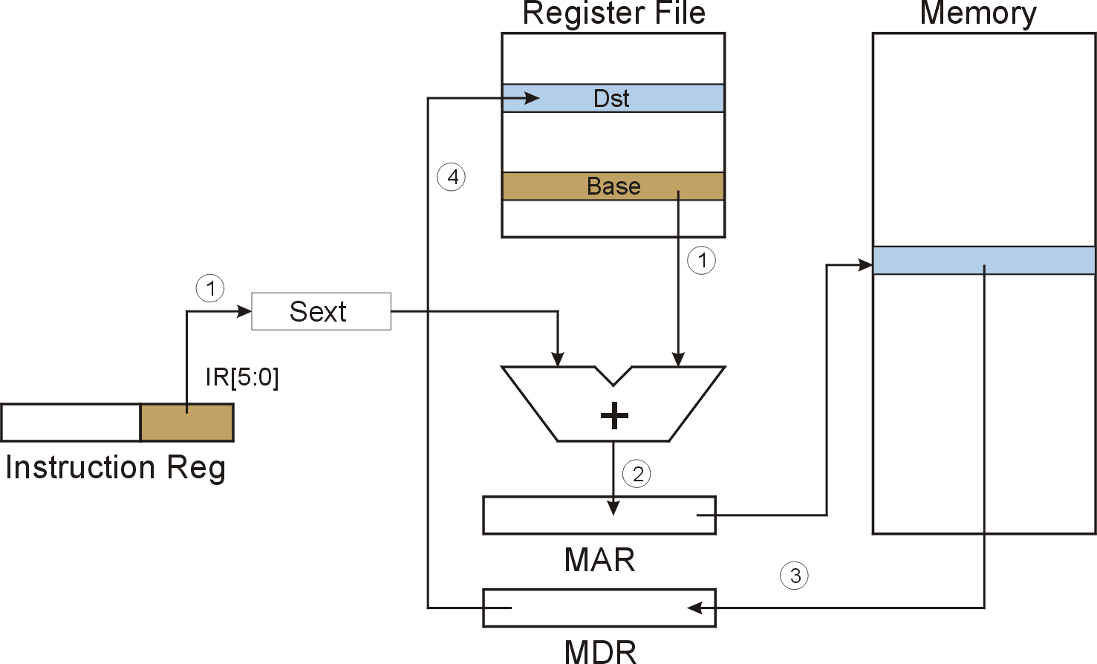
LDR (Base+Offset) LDR DR, BaseR, offset6
LDR
Notes:
73

Slide 74
F
D
EA
LDR (Base+Offset)
OP
16
GatePC
16
GateMARMUX
EX
LD.PC
PC
DR
3
MARMUX
+1
REG FILE
16
2
PCMUX
16
16
16
16
16
LD.REG
S
[7:0]
SR2
SR2
OUT
SR1
OUT
SR1
SEXT
+
3
3
ADDR2MUX
MUX
MUX
ADDR1MUX
16
16
[10:0]
16
16
16
16
16
SEXT
[8:0]
LD.CC
16
SEXT
FINITE STATE MACHINE
SR2MUX
[5:0]
SEXT
16
N
Z
P
ALUK
A
B
[4:0]
SEXT
2
ALU
LD.IR
IR
LOGIC
…
16
16
16
RUN
GateALU
16
GateMDR
16
LD.MDR
MDR
MEMORY
MAR
LD.MAR
16
INPUT
OUTPUT
MIO.EN
MUX
16
MEM.EN,R,W

Slide 75
F
D
EA
LDR (Base+Offset)
OP
16
GatePC
16
GateMARMUX
EX
LD.PC
PC
DR
3
MARMUX
+1
REG FILE
16
2
PCMUX
16
16
16
16
16
LD.REG
S
[7:0]
SR2
SR2
OUT
SR1
OUT
SR1
SEXT
+
3
3
ADDR2MUX
MUX
MUX
ADDR1MUX
16
16
[10:0]
16
16
16
16
16
SEXT
[8:0]
LD.CC
16
SEXT
FINITE STATE MACHINE
SR2MUX
[5:0]
SEXT
16
N
Z
P
ALUK
A
B
[4:0]
SEXT
2
ALU
LD.IR
IR
LOGIC
…
16
16
16
RUN
GateALU
16
GateMDR
16
LD.MDR
MDR
MEMORY
MAR
LD.MAR
16
INPUT
OUTPUT
MIO.EN
MUX
16
MEM.EN,R,W

Slide 76
F
D
EA
LDR (Base+Offset)
OP
16
GatePC
16
GateMARMUX
EX
LD.PC
PC
DR
3
MARMUX
+1
REG FILE
16
2
PCMUX
16
16
16
16
16
LD.REG
S
[7:0]
SR2
SR2
OUT
SR1
OUT
SR1
SEXT
+
3
3
ADDR2MUX
MUX
MUX
ADDR1MUX
16
16
[10:0]
16
16
16
16
16
SEXT
[8:0]
LD.CC
16
SEXT
FINITE STATE MACHINE
SR2MUX
[5:0]
SEXT
16
N
Z
P
ALUK
A
B
[4:0]
SEXT
2
ALU
LD.IR
IR
LOGIC
…
16
16
16
RUN
GateALU
16
GateMDR
16
LD.MDR
MDR
MEMORY
MAR
LD.MAR
16
INPUT
OUTPUT
MIO.EN
MUX
16
MEM.EN,R,W

Slide 77
LDR (Base+Offset)
F
D
EA
OP
EX
S
16
GatePC
16
GateMARMUX
LD.PC
PC
DR
3
MARMUX
+1
REG FILE
16
2
PCMUX
16
16
16
16
16
LD.REG
[7:0]
SR2
SR2
OUT
SR1
OUT
SR1
SEXT
+
3
3
ADDR2MUX
MUX
MUX
ADDR1MUX
16
16
[10:0]
16
16
16
16
16
SEXT
[8:0]
LD.CC
16
SEXT
FINITE STATE MACHINE
SR2MUX
[5:0]
SEXT
16
N
Z
P
ALUK
A
B
[4:0]
SEXT
2
ALU
LD.IR
IR
LOGIC
…
16
16
16
RUN
GateALU
16
GateMDR
16
LD.MDR
MDR
MEMORY
MAR
LD.MAR
16
INPUT
OUTPUT
MIO.EN
MUX
16
MEM.EN,R,W

Slide 78
D
EA
LDR (Base+Offset)
D
OP
16
GatePC
16
GateMARMUX
EX
LD.PC
PC
DR
3
MARMUX
+1
REG FILE
16
2
PCMUX
16
16
16
16
16
LD.REG
S
[7:0]
SR2
SR2
OUT
SR1
OUT
SR1
SEXT
+
3
3
ADDR2MUX
MUX
MUX
ADDR1MUX
16
16
[10:0]
16
16
16
16
16
SEXT
[8:0]
LD.CC
16
SEXT
FINITE STATE MACHINE
SR2MUX
[5:0]
SEXT
16
N
Z
P
ALUK
A
B
[4:0]
SEXT
2
ALU
LD.IR
IR
LOGIC
…
16
16
16
RUN
GateALU
16
GateMDR
16
LD.MDR
MDR
MEMORY
MAR
LD.MAR
16
INPUT
OUTPUT
MIO.EN
MUX
16
MEM.EN,R,W

Slide 79
D
EA
LDR (Base+Offset)
F
EX
OP
16
GatePC
16
GateMARMUX
LD.PC
PC
DR
3
MARMUX
+1
REG FILE
16
2
PCMUX
16
16
16
16
16
LD.REG
S
[7:0]
SR2
SR2
OUT
SR1
OUT
SR1
SEXT
+
3
3
ADDR2MUX
MUX
MUX
ADDR1MUX
16
16
[10:0]
16
16
16
16
16
SEXT
[8:0]
LD.CC
16
SEXT
FINITE STATE MACHINE
SR2MUX
[5:0]
SEXT
16
N
Z
P
ALUK
A
B
[4:0]
SEXT
2
ALU
LD.IR
IR
LOGIC
…
16
16
16
GateALU
RUN
16
GateMDR
16
LD.MDR
MDR
MEMORY
MAR
LD.MAR
16
INPUT
OUTPUT
MIO.EN
MUX
16
MEM.EN,R,W

Slide 80
LDR (Base+Offset) : LD R1, R3, x1D
Register File
Memory
R0
R1
0
0
0
0
0
0
0
0
0
0
0
0
0
1
0
1
R2
IR
0
1
1
0
0
0
1
0
1
1
0
1
1
1
0
1
R3
0
0
1
0
0
0
1
1
0
1
0
0
0
1
0
1
①
R4
IR[5:0]=011101
R5
SEXT
R6
x2362
R7
0
0
0
0
0
0
0
0
0
0
0
0
0
1
0
1
0000000000011101 = x1D
x2345
A
B
+
PC = x4018
PC+1 = x4019
x1D + x2345 = x2362
②
④
③
x2362
x2362
MAR
③
# 5
MDR
Notes:
80

Slide 81

STR (Base+Offset) STR DR, BaseR, offset6
STR
Notes:
81

Slide 82
F
D
EA
STR (Base+Offset)
OP
16
GatePC
16
GateMARMUX
EX
LD.PC
PC
DR
3
MARMUX
+1
REG FILE
16
2
PCMUX
16
16
16
16
16
LD.REG
S
[7:0]
SR2
SR2
OUT
SR1
OUT
SR1
SEXT
+
3
3
ADDR2MUX
MUX
MUX
ADDR1MUX
16
16
[10:0]
16
16
16
16
16
SEXT
[8:0]
LD.CC
16
SEXT
FINITE STATE MACHINE
SR2MUX
[5:0]
SEXT
16
N
Z
P
ALUK
A
B
[4:0]
SEXT
2
ALU
LD.IR
IR
LOGIC
…
16
16
16
RUN
GateALU
16
GateMDR
16
LD.MDR
MDR
MEMORY
MAR
LD.MAR
16
INPUT
OUTPUT
MIO.EN
MUX
16
MEM.EN,R,W

Slide 83
F
D
EA
STR (Base+Offset)
OP
16
GatePC
16
GateMARMUX
EX
LD.PC
PC
DR
3
MARMUX
+1
REG FILE
16
2
PCMUX
16
16
16
16
16
LD.REG
S
[7:0]
SR2
SR2
OUT
SR1
OUT
SR1
SEXT
+
3
3
ADDR2MUX
MUX
MUX
ADDR1MUX
16
16
[10:0]
16
16
16
16
16
SEXT
[8:0]
LD.CC
16
SEXT
FINITE STATE MACHINE
SR2MUX
[5:0]
SEXT
16
N
Z
P
ALUK
A
B
[4:0]
SEXT
2
ALU
LD.IR
IR
LOGIC
…
16
16
16
RUN
GateALU
16
GateMDR
16
LD.MDR
MDR
MEMORY
MAR
LD.MAR
16
INPUT
OUTPUT
MIO.EN
MUX
16
MEM.EN,R,W

Slide 84
F
D
EA
STR (Base+Offset)
OP
16
GatePC
16
GateMARMUX
EX
LD.PC
PC
DR
3
MARMUX
+1
REG FILE
16
2
PCMUX
16
16
16
16
16
LD.REG
S
[7:0]
SR2
SR2
OUT
SR1
OUT
SR1
SEXT
+
3
3
ADDR2MUX
MUX
MUX
ADDR1MUX
16
16
[10:0]
16
16
16
16
16
SEXT
[8:0]
LD.CC
16
SEXT
FINITE STATE MACHINE
SR2MUX
[5:0]
SEXT
16
N
Z
P
ALUK
A
B
[4:0]
SEXT
2
ALU
LD.IR
IR
LOGIC
…
16
16
16
RUN
GateALU
16
GateMDR
16
LD.MDR
MDR
MEMORY
MAR
LD.MAR
16
INPUT
OUTPUT
MIO.EN
MUX
16
MEM.EN,R,W

Slide 85
STR (Base+Offset)
F
D
EA
OP
EX
S
16
GatePC
16
GateMARMUX
LD.PC
PC
DR
3
MARMUX
+1
REG FILE
16
2
PCMUX
16
16
16
16
16
LD.REG
[7:0]
SR2
SR2
OUT
SR1
OUT
SR1
SEXT
+
3
3
ADDR2MUX
MUX
MUX
ADDR1MUX
16
16
[10:0]
16
16
16
16
16
SEXT
[8:0]
LD.CC
16
SEXT
FINITE STATE MACHINE
SR2MUX
[5:0]
SEXT
16
N
Z
P
ALUK
A
B
[4:0]
SEXT
2
ALU
LD.IR
IR
LOGIC
…
16
16
16
RUN
GateALU
16
GateMDR
16
LD.MDR
MDR
MEMORY
MAR
LD.MAR
16
INPUT
OUTPUT
MIO.EN
MUX
16
MEM.EN,R,W

Slide 86
D
EA
STR (Base+Offset)
F
EX
OP
OP
16
GatePC
16
GateMARMUX
LD.PC
PC
DR
3
MARMUX
+1
REG FILE
16
2
PCMUX
16
16
16
16
16
LD.REG
[7:0]
SR2
SR2
OUT
SR1
OUT
SR1
SEXT
+
3
3
ADDR2MUX
MUX
MUX
ADDR1MUX
16
16
[10:0]
16
16
16
16
16
SEXT
[8:0]
LD.CC
16
SEXT
FINITE STATE MACHINE
SR2MUX
[5:0]
SEXT
16
N
Z
P
ALUK
A
B
[4:0]
SEXT
2
ALU
LD.IR
IR
LOGIC
…
16
16
16
GateALU
RUN
16
GateMDR
16
LD.MDR
MDR
MEMORY
MAR
LD.MAR
16
INPUT
OUTPUT
MIO.EN
MUX
16
MEM.EN,R,W

Slide 87
D
EA
STR (Base+Offset)
F
OP
EX
S
16
GatePC
16
GateMARMUX
LD.PC
PC
DR
3
MARMUX
+1
REG FILE
16
2
PCMUX
16
16
16
16
16
LD.REG
[7:0]
SR2
SR2
OUT
SR1
OUT
SR1
SEXT
+
3
3
ADDR2MUX
MUX
MUX
ADDR1MUX
16
16
[10:0]
16
16
16
16
16
SEXT
[8:0]
LD.CC
16
SEXT
FINITE STATE MACHINE
SR2MUX
[5:0]
SEXT
16
N
Z
P
ALUK
A
B
[4:0]
SEXT
2
ALU
LD.IR
IR
LOGIC
…
16
16
16
RUN
GateALU
16
GateMDR
16
LD.MDR
MDR
MEMORY
MAR
LD.MAR
16
INPUT
OUTPUT
MIO.EN
MUX
16
MEM.EN,R,W

Slide 88
Load Effective Address
Computes address like PC-relative (PC plus signed offset) and stores the result into a register.
Note: The address is stored in the register,
not the contents of the memory location.

Slide 89
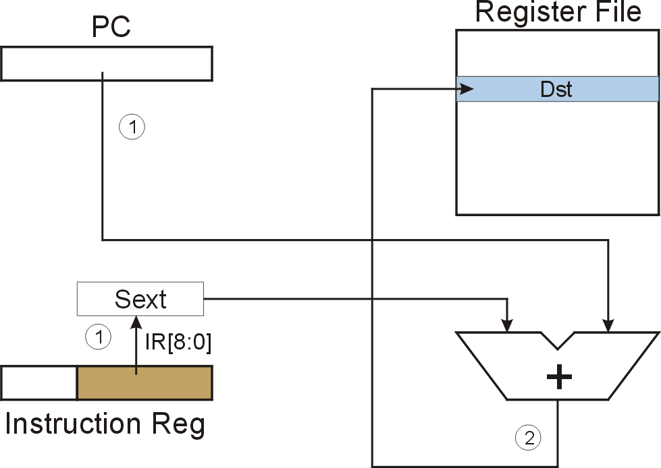
LEA (Immediate) LD DR, PCoffset9
LEA
Notes:
89

Slide 90
F
D
EA
LEA (Immediate)
OP
16
GatePC
16
GateMARMUX
EX
LD.PC
PC
DR
3
MARMUX
+1
REG FILE
16
2
PCMUX
16
16
16
16
16
LD.REG
S
[7:0]
SR2
SR2
OUT
SR1
OUT
SR1
SEXT
+
3
3
ADDR2MUX
MUX
MUX
ADDR1MUX
16
16
[10:0]
16
16
16
16
16
SEXT
[8:0]
LD.CC
16
SEXT
FINITE STATE MACHINE
SR2MUX
[5:0]
SEXT
16
N
Z
P
ALUK
A
B
[4:0]
SEXT
2
ALU
LD.IR
IR
LOGIC
…
16
16
16
RUN
GateALU
16
GateMDR
16
LD.MDR
MDR
MEMORY
MAR
LD.MAR
16
INPUT
OUTPUT
MIO.EN
MUX
16
MEM.EN,R,W

Slide 91
F
D
EA
LEA (Immediate)
OP
16
GatePC
16
GateMARMUX
EX
LD.PC
PC
DR
3
MARMUX
+1
REG FILE
16
2
PCMUX
16
16
16
16
16
LD.REG
S
[7:0]
SR2
SR2
OUT
SR1
OUT
SR1
SEXT
+
3
3
ADDR2MUX
MUX
MUX
ADDR1MUX
16
16
[10:0]
16
16
16
16
16
SEXT
[8:0]
LD.CC
16
SEXT
FINITE STATE MACHINE
SR2MUX
[5:0]
SEXT
16
N
Z
P
ALUK
A
B
[4:0]
SEXT
2
ALU
LD.IR
IR
LOGIC
…
16
16
16
RUN
GateALU
16
GateMDR
16
LD.MDR
MDR
MEMORY
MAR
LD.MAR
16
INPUT
OUTPUT
MIO.EN
MUX
16
MEM.EN,R,W

Slide 92
F
D
EA
LEA (Immediate)
OP
16
GatePC
16
GateMARMUX
EX
LD.PC
PC
DR
3
MARMUX
+1
REG FILE
16
2
PCMUX
16
16
16
16
16
LD.REG
S
[7:0]
SR2
SR2
OUT
SR1
OUT
SR1
SEXT
+
3
3
ADDR2MUX
MUX
MUX
ADDR1MUX
16
16
[10:0]
16
16
16
16
16
SEXT
[8:0]
LD.CC
16
SEXT
FINITE STATE MACHINE
SR2MUX
[5:0]
SEXT
16
N
Z
P
ALUK
A
B
[4:0]
SEXT
2
ALU
LD.IR
IR
LOGIC
…
16
16
16
RUN
GateALU
16
GateMDR
16
LD.MDR
MDR
MEMORY
MAR
LD.MAR
16
INPUT
OUTPUT
MIO.EN
MUX
16
MEM.EN,R,W

Slide 93
LEA (Immediate)
F
D
EA
OP
EX
S
16
GatePC
16
GateMARMUX
LD.PC
PC
DR
3
MARMUX
+1
REG FILE
16
2
PCMUX
16
16
16
16
16
LD.REG
[7:0]
SR2
SR2
OUT
SR1
OUT
SR1
SEXT
+
3
3
ADDR2MUX
MUX
MUX
ADDR1MUX
16
16
[10:0]
16
16
16
16
16
SEXT
[8:0]
LD.CC
16
SEXT
FINITE STATE MACHINE
SR2MUX
[5:0]
SEXT
16
N
Z
P
ALUK
A
B
[4:0]
SEXT
2
ALU
LD.IR
IR
LOGIC
…
16
16
16
RUN
GateALU
16
GateMDR
16
LD.MDR
MDR
MEMORY
MAR
LD.MAR
16
INPUT
OUTPUT
MIO.EN
MUX
16
MEM.EN,R,W

Slide 94
LEA (Immediate): LEA R1, x1AF
Register File
PC
0
1
0
0
0
0
0
0
0
0
0
1
1
0
0
1
R0
R1
0
0
1
1
1
1
1
1
1
0
1
1
1
0
0
0
R2
IR
0
0
1
0
0
0
1
1
1
0
1
0
1
1
1
1
R3
①
①
R4
IR[8:0]=110101111
R5
SEXT
R6
1111111110101111 = xFFAF
R7
x4019
A
B
+
PC = x4018
PC+1 = x4019
X4019 + xFFAF = x3FC8
②
x3FC8
Notes:
94

Slide 95
Example
Address | Instruction | Comments
x30F6 | 1 1 1 0 0 0 1 1 1 1 1 1 1 1 0 1 | R1 ← PC – 3 = x30F4
x30F7 | 0 0 0 1 0 1 0 0 0 1 1 0 1 1 1 0 | R2 ← R1 + 14 = x3102
x30F8 | 0 0 1 1 0 1 0 1 1 1 1 1 1 0 1 1 | M[PC - 5] ← R2; i.e. M[x30F4] ← x3102
x30F9 | 0 1 0 1 0 1 0 0 1 0 1 0 0 0 0 0 | R2 ← 0
x30FA | 0 0 0 1 0 1 0 0 1 0 1 0 0 1 0 1 | R2 ← R2 + 5 = 5
x30FB | 0 1 1 1 0 1 0 0 0 1 0 0 1 1 1 0 | M[R1+14] ← R2; i.e. M[x3102] ← 5
x30FC | 1 0 1 0 0 1 1 1 1 1 1 1 0 1 1 1 | R3 ← M[M[PC-9]] = M[M[x30F4]] = M[x3102] = 5
opcode
Notes:
95

Slide 96
LC-3 ISA Overview
_{运算指令}
15
14
13
12
11
10
9
8
7
6
5
4
3
2
1
₀
ADD
₀
₀
₀
1
DR
SR1
₀
₀
₀
SR2
移动数据指令
ADD
₀
₀
₀
1
DR
SR1
1
_{Imm5}
取数指令
AND
₀
1
₀
1
DR
SR1
₀
₀
₀
SR2
AND
₀
1
₀
1
DR
SR1
1
Imm5
15
14
13
12
11
10
9
8
7
6
5
4
3
2
1
₀
LD
₀
₀
1
0
DR
_{PCoffset9}
NOT
1
₀
₀
1
DR
SR1
1
1
1
1
1
1
LDR
₀
₁
1
0
DR
BaseR
PCoffset6
Reserved
1
1
₀
1
LDI
₁
₀
1
0
DR
PCoffset9
控制指令
LEA
₁
₁
1
0
DR
PCoffset9
15
14
13
12
11
10
9
8
7
6
5
4
3
2
1
₀
BR
₀
₀
0
0
n
z
_{p}
PCoffset9
存数指令
JSR
₀
1
0
0
1
PCoffset11
15
14
13
12
11
10
9
8
7
6
5
4
3
2
1
₀
JSRR
₀
1
0
0
₀
₀
₀
BaseR
₀
₀
₀
₀
₀
₀
ST
₀
₀
1
1
SR
PCoffset9
RTI
1
₀
0
0
₀
₀
₀
₀
₀
₀
₀
₀
₀
₀
₀
₀
STR
₀
1
1
1
SR
BaseR
PCoffset6
JMP
1
1
0
0
₀
₀
₀
BaseR
₀
₀
₀
₀
₀
₀
STI
1
₀
1
1
SR
PCoffset9
RET
1
1
0
0
₀
₀
₀
1
1
1
₀
₀
₀
₀
₀
₀
TRAP
1
1
1
1
₀
₀
₀
₀
TrapVector8

Slide 97
Control Instructions
15
14
13
12
11
10
9
8
7
6
5
4
3
2
1
0
BR
0
0
0
0
n
z
p
PCoffset9
JSR
0
1
0
0
1
PCoffset11
JSRR
0
1
0
0
0
0
0
BaseR
0
0
0
0
0
0
RTI
1
0
0
0
0
0
0
0
0
0
0
0
0
0
0
0
JMP
1
1
0
0
0
0
0
BaseR
0
0
0
0
0
0
RET
1
1
0
0
0
0
0
1
1
1
0
0
0
0
0
0
TRAP
1
1
1
1
0
0
0
0
TrapVector8

Slide 98
Control Instructions
Used to alter the sequence of instructions (by changing the Program Counter)
Conditional Branch
  branch is taken if a specified condition is true
    signed offset is added to PC to yield new PC
  else, the branch is not taken
    PC is not changed, points to the next sequential instruction
Unconditional Branch (or Jump)
  always changes the PC
TRAP
  changes PC to the address of an OS “service routine”
  routine will return control to the next instruction (after TRAP)
Notes:
98

Slide 99
Condition Codes
LC-3 has three condition code registers:
N -- negative
Z -- zero
P -- positive (greater than zero)
Set by any instruction that writes a value to a register
(ADD, AND, NOT, LD, LDR, LDI, LEA)
Exactly one will be set at all times
  Based on the last instruction that altered a register

Slide 100
Branch Instruction
Branch specifies one or more condition codes.
If the specified bit is set, the branch is taken.
  PC-relative addressing:
  target address is made by adding signed offset (IR[8:0])
  to current PC.
  Note: PC has already been incremented by FETCH stage.
  Note: Target must be within 256 words of BR instruction.
If the branch is not taken, the next sequential instruction is executed.

Slide 101
BR (PC-Relative)
IR[11:9]
①
IR
_{N}
_{Z}
_{P}
IR[8:0]
PC
_{N}
Z
P
0
1
①
0
SEXT
①
③
+
②
taken =“yes”
_{PCMUX}
②
What happens if bits [11:9] are all zero?
What happens if bits [11:9] are all one?
Notes:
101
If all zero, no CC is tested, so branch is never taken. (See Appendix B.)
If all one, then all are tested. Since at least one of the CC bits is set to one after each operate/load instruction, then branch is always taken. (Assumes some instruction has set CC before branch instruction, otherwise undefined.)

Slide 102
F
D
EA
BR (PC-Relative)
OP
16
GatePC
16
GateMARMUX
EX
LD.PC
PC
DR
3
MARMUX
+1
REG FILE
16
2
PCMUX
16
16
16
16
16
LD.REG
S
[7:0]
SR2
SR2
OUT
SR1
OUT
SR1
SEXT
+
3
3
ADDR2MUX
MUX
MUX
ADDR1MUX
16
16
[10:0]
16
16
16
16
16
SEXT
[8:0]
LD.CC
16
SEXT
FINITE STATE MACHINE
SR2MUX
[5:0]
SEXT
16
N
Z
P
ALUK
A
B
[4:0]
SEXT
2
ALU
LD.IR
IR
LOGIC
…
16
16
16
RUN
GateALU
16
GateMDR
16
LD.MDR
MDR
MEMORY
MAR
LD.MAR
16
INPUT
OUTPUT
MIO.EN
MUX
16
MEM.EN,R,W

Slide 103
F
D
EA
BR (PC-Relative)
OP
16
GatePC
16
GateMARMUX
EX
LD.PC
PC
DR
3
MARMUX
+1
REG FILE
16
2
PCMUX
16
16
16
16
16
LD.REG
S
[7:0]
SR2
SR2
OUT
SR1
OUT
SR1
SEXT
+
3
3
ADDR2MUX
MUX
MUX
ADDR1MUX
16
16
[10:0]
16
16
16
16
16
SEXT
[8:0]
LD.CC
16
SEXT
FINITE STATE MACHINE
SR2MUX
[5:0]
SEXT
16
N
Z
P
ALUK
A
B
[4:0]
SEXT
2
ALU
LD.IR
IR
LOGIC
…
16
16
16
RUN
GateALU
16
GateMDR
16
LD.MDR
MDR
MEMORY
MAR
LD.MAR
16
INPUT
OUTPUT
MIO.EN
MUX
16
MEM.EN,R,W

Slide 104
F
D
EA
BR (PC-Relative)
OP
16
GatePC
16
GateMARMUX
EX
LD.PC
PC
DR
3
MARMUX
+1
REG FILE
16
2
PCMUX
16
16
16
16
16
LD.REG
S
[7:0]
SR2
SR2
OUT
SR1
OUT
SR1
SEXT
+
3
3
ADDR2MUX
MUX
MUX
ADDR1MUX
16
16
[10:0]
16
16
16
16
16
SEXT
[8:0]
LD.CC
16
SEXT
FINITE STATE MACHINE
SR2MUX
[5:0]
SEXT
16
N
Z
P
ALUK
A
B
[4:0]
SEXT
2
ALU
LD.IR
IR
LOGIC
…
16
16
16
RUN
GateALU
16
GateMDR
16
LD.MDR
MDR
MEMORY
MAR
LD.MAR
16
INPUT
OUTPUT
MIO.EN
MUX
16
MEM.EN,R,W

Slide 105
BR (PC-Relative)
F
D
EA
OP
EX
S
16
GatePC
16
GateMARMUX
LD.PC
PC
DR
3
MARMUX
+1
REG FILE
taken
2
PCMUX
16
LD.REG
16
16
16
16
16
[7:0]
SR2
SR2
OUT
SR1
OUT
SR1
SEXT
+
3
3
ADDR2MUX
MUX
MUX
ADDR1MUX
16
16
[10:0]
16
16
16
16
16
SEXT
[8:0]
LD.CC
16
SEXT
FINITE STATE MACHINE
SR2MUX
[5:0]
SEXT
16
N
Z
P
ALUK
A
B
[4:0]
SEXT
2
ALU
LD.IR
IR
LOGIC
…
16
16
16
RUN
GateALU
16
GateMDR
16
LD.MDR
MDR
MEMORY
MAR
LD.MAR
16
INPUT
OUTPUT
MIO.EN
MUX
16
MEM.EN,R,W

Slide 106
BR (PC-Relative)
F
D
EA
OP
EX
S
16
GatePC
16
GateMARMUX
LD.PC
PC
DR
3
MARMUX
+1
REG FILE
taken
2
PCMUX
16
LD.REG
16
16
16
16
16
[7:0]
SR2
SR2
OUT
SR1
OUT
SR1
SEXT
+
3
3
ADDR2MUX
MUX
MUX
ADDR1MUX
16
16
[10:0]
16
16
16
16
16
SEXT
[8:0]
LD.CC
16
SEXT
FINITE STATE MACHINE
SR2MUX
[5:0]
SEXT
16
N
Z
P
ALUK
A
B
[4:0]
SEXT
2
ALU
LD.IR
IR
LOGIC
…
16
16
16
RUN
GateALU
16
GateMDR
16
LD.MDR
MDR
MEMORY
MAR
LD.MAR
16
INPUT
OUTPUT
MIO.EN
MUX
16
MEM.EN,R,W

Slide 107
BR (PC-Relative): BR_{z} x4101
IR[11:9]
IR
0
0
0
0
0
1
0
0
1
1
0
1
1
0
0
1
PC
0
1
0
0
0
0
0
0
0
0
1
0
1
0
0
0
①
IR[8:0] = xD9
①
③
_{N}
Z
P
0
1
①
0
SEXT
①
0000 0000 1101 1001 = x00D9
0100 0001 0000 0001= x4101
+
PC = x4027
PC+1 = x4028
x4028 + x00D9 = x4101
②
taken =“yes”
_{PCMUX}
②
What happens if bits [11:9] are all zero?
What happens if bits [11:9] are all one?
Notes:
107
If all zero, no CC is tested, so branch is never taken. (See Appendix B.)
If all one, then all are tested. Since at least one of the CC bits is set to one after each operate/load instruction, then branch is always taken. (Assumes some instruction has set CC before branch instruction, otherwise undefined.)

Slide 108
BR (PC-Relative)
Check
  BR_{nzp} x4101 ；if (n=1 or z=1 or p=1)
  BR_{n} x4101 ；if (n=1)
  BR_{z} x4101 ；if (z=1)
  BR_{p} x4101 ；if (p=1)
  BR_{nz} x4101 ；if (n=1 or z=1)
  BR_{np} x4101 ；if (n=1 or p=1)
  BR_{zp} x4101 ；if (z=1 or p=1)
  BR x4101 ；JMP x4101
Set
  If DR < 0, set N=1 and Z=0 and P=0
  If DR = 0, set N=0 and Z=1 and P=0
  If DR > 0, set N=0 and Z=0 and P=1

Slide 109
Using Branch Instructions
Memory
Compute sum of 12 integers.
Numbers start at location x3100.
Program starts at location x3000.
Register File
R0
x3100
R1
R2
12
x3000
R3
0
Program
The use of a counter
R4
temp
R5
R1 ← x3100
R3 ← 0
R2 ← 12
R6
R7
x3009
x300A
PC
x3000
R2=0?
R4 ← M[R1]
R3 ← R3+R4
R1 ← R1+1
R2 ← R2-1
NO
x3100
Number 1
Data
YES
Two Method for Loop Control
The use of a counter
The use of a sentinel
x310B
Number 12
x310C
Notes:
109

Slide 110
Sample Program(The use of a counter)
Address | Instruction | Comments
x3000 | 1 1 1 0 0 0 1 0 1 1 1 1 1 1 1 1 | R1 ← x3100 (PC+0xFF)
x3001 | 0 1 0 1 0 1 1 0 1 1 1 0 0 0 0 0 | R3 ← 0
x3002 | 0 1 0 1 0 1 0 0 1 0 1 0 0 0 0 0 | R2 ← 0
x3003 | 0 0 0 1 0 1 0 0 1 0 1 0 1 1 0 0 | R2 ← 12
x3004 | 0 0 0 0 0 1 0 0 0 0 0 0 0 1 0 1 | If Z, goto (PC+5) = x300A
x3005 | 0 1 1 0 1 0 0 0 0 1 0 0 0 0 0 0 | Load next value to R4
x3006 | 0 0 0 1 0 1 1 0 1 1 0 0 0 1 0 0 | R3 ← R3 + R4
x3007 | 0 0 0 1 0 0 1 0 0 1 1 0 0 0 0 1 | Increment R1 (pointer)
X3008 | 0 0 0 1 0 1 0 0 1 0 1 1 1 1 1 1 | Decrement R2 (counter)
x3009 | 0 0 0 0 1 1 1 1 1 1 1 1 1 0 1 0 | Goto (PC-6)=x3004

Slide 111
Using Branch Instructions
A special character used to indicate the end of a sequence
is often called a sentinel.
Useful when you don’t know ahead of time how many timesto execute a loop.
The use of a sentinel
R1 ← x3100
R3 ← 0
R4 ← M[R1]
R4=-1?
R3 ← R3+R4
R1 ← R1+1
R4 ← M[R1]
NO
YES
2018/10/25
111
Compute sum of 12 integers.
Numbers start at location x3100.
Program starts at location x3000.
Notes:
111

Slide 112
Using Branch Instructions
Register File
Memory
R0
x3100
R1
R2
12
x3000
R3
0
Program
R4
temp
The use of a sentinel
R5
R6
R1 ← x3100
R3 ← 0
R4 ← M[R1]
R7
x3009
x300A
PC
x3000
R4=-1?
R3 ← R3+R4
R1 ← R1+1
R4 ← M[R1]
NO
x3100
Number 1
Data
YES
x310B
Number 12
x310C
-1
2018/10/25
112
Compute sum of 12 integers.
Numbers start at location x3100.
Program starts at location x3000.
Notes:
112

Slide 113
Sample Program(The use of a sentinel)
Address | Instruction | Comments
x3000 | 1 1 1 0 0 0 1 0 1 1 1 1 1 1 1 1 | R1 ← (PC+0xFF)=x3100
x3001 | 0 1 0 1 0 1 1 0 1 1 1 0 0 0 0 0 | R3 ← 0
x3002 | 0 1 1 0 1 0 0 0 0 1 0 0 0 0 0 0 | R4 ← M[R1]
X3003 | 0 0 0 0 1 0 0 0 0 0 0 0 0 1 0 0 | If N, goto (PC+ 4)=X3008
X3004 | 0 0 0 1 0 1 1 0 1 1 0 0 0 1 0 0 | R3 ← R3 + R4
X3005 | 0 0 0 1 0 0 1 0 0 1 1 0 0 0 0 1 | R1 ← R1 + 1
X3006 | 0 1 1 0 1 0 0 0 0 1 0 0 0 0 0 0 | R4 ← M[R1]
x3007 | 0 0 0 0 1 1 1 1 1 1 1 1 1 0 1 1 | Goto (PC-5)= x3003
2018/10/25
113

Slide 114
Using Branch Instructions(Code Optimization)
Compute sum of 12 integers.
Numbers start at location x3100.
Program starts at location x3000.
R1 ← x3100
R3 ← 0
R4 ← M[R1]
R1 ← x3100
R3 ← 0
R4=-1?
R3 ← R3+R4
R1 ← R1+1
R4 ← M[R1]
R4 ← M[R1]
NO
R4=-1?
R3 ← R3+R4
R1 ← R1+1
YES
NO
YES
2018/10/25
114
Notes:
114

Slide 115
Sample Program
Address | Instruction | Comments
x3000 | 1 1 1 0 0 0 1 0 1 1 1 1 1 1 1 1 | R1 ← (PC+0xFF)= x3100
x3001 | 0 1 0 1 0 1 1 0 1 1 1 0 0 0 0 0 | R3 ← 0
x3002 | 0 1 1 0 1 0 0 0 0 1 0 0 0 0 0 0 | R4 ← M[R1]
X3003 | 0 0 0 0 1 0 0 0 0 0 0 0 0 0 1 1 | If N, goto (PC+ 3)=X3007
X3004 | 0 0 0 1 0 1 1 0 1 1 0 0 0 1 0 0 | R3 ← R3 + R4
X3005 | 0 0 0 1 0 0 1 0 0 1 1 0 0 0 0 1 | R1 ← R1 + 1
x3006 | 0 0 0 0 1 1 1 1 1 1 1 1 1 0 1 1 | Goto (PC-5)= x3002
2018/10/25
115

Slide 116
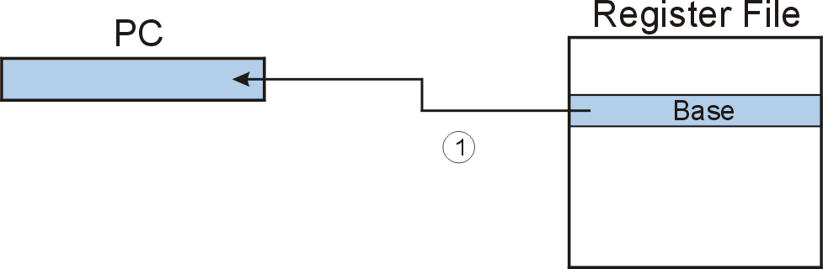
JMP (Register)
Jump is an unconditional branch -- always taken.
  Target address is the contents of a register.
  Allows any target address.

Slide 117
F
D
EA
JMP (Register)
OP
16
GatePC
16
GateMARMUX
EX
LD.PC
PC
DR
3
MARMUX
+1
REG FILE
16
2
PCMUX
16
16
16
16
16
LD.REG
S
[7:0]
SR2
SR2
OUT
SR1
OUT
SR1
SEXT
+
3
3
ADDR2MUX
MUX
MUX
ADDR1MUX
16
16
[10:0]
16
16
16
16
16
SEXT
[8:0]
LD.CC
16
SEXT
FINITE STATE MACHINE
SR2MUX
[5:0]
SEXT
16
N
Z
P
ALUK
A
B
[4:0]
SEXT
2
ALU
LD.IR
IR
LOGIC
…
16
16
16
RUN
GateALU
16
GateMDR
16
LD.MDR
MDR
MEMORY
MAR
LD.MAR
16
INPUT
OUTPUT
MIO.EN
MUX
16
MEM.EN,R,W

Slide 118
F
D
EA
JMP (Register)
OP
16
GatePC
16
GateMARMUX
EX
LD.PC
PC
DR
3
MARMUX
+1
REG FILE
16
2
PCMUX
16
16
16
16
16
LD.REG
S
[7:0]
SR2
SR2
OUT
SR1
OUT
SR1
SEXT
+
3
3
ADDR2MUX
MUX
MUX
ADDR1MUX
16
16
[10:0]
16
16
16
16
16
SEXT
[8:0]
LD.CC
16
SEXT
FINITE STATE MACHINE
SR2MUX
[5:0]
SEXT
16
N
Z
P
ALUK
A
B
[4:0]
SEXT
2
ALU
LD.IR
IR
LOGIC
…
16
16
16
RUN
GateALU
16
GateMDR
16
LD.MDR
MDR
MEMORY
MAR
LD.MAR
16
INPUT
OUTPUT
MIO.EN
MUX
16
MEM.EN,R,W

Slide 119
F
D
EA
JMP (Register)
OP
16
GatePC
16
GateMARMUX
EX
LD.PC
PC
DR
3
MARMUX
+1
REG FILE
16
2
PCMUX
16
16
16
16
16
LD.REG
S
[7:0]
SR2
SR2
OUT
SR1
OUT
SR1
SEXT
+
3
3
ADDR2MUX
MUX
MUX
ADDR1MUX
16
16
[10:0]
16
16
16
16
16
SEXT
[8:0]
LD.CC
16
SEXT
FINITE STATE MACHINE
SR2MUX
[5:0]
SEXT
16
N
Z
P
ALUK
A
B
[4:0]
SEXT
2
ALU
LD.IR
IR
LOGIC
…
16
16
16
RUN
GateALU
16
GateMDR
16
LD.MDR
MDR
MEMORY
MAR
LD.MAR
16
INPUT
OUTPUT
MIO.EN
MUX
16
MEM.EN,R,W

Slide 120
JMP R7(Register)
F
D
EA
OP
EX
S
16
GatePC
16
GateMARMUX
LD.PC
PC
DR
3
MARMUX
+1
REG FILE
16
2
PCMUX
16
16
16
16
16
LD.REG
[7:0]
SR2
SR2
OUT
SR1
OUT
SR1
SEXT
+
3
3
ADDR2MUX
MUX
MUX
ADDR1MUX
16
16
[10:0]
16
16
16
16
16
SEXT
[8:0]
LD.CC
16
SEXT
FINITE STATE MACHINE
SR2MUX
[5:0]
SEXT
16
N
Z
P
ALUK
A
B
[4:0]
SEXT
2
ALU
LD.IR
IR
LOGIC
…
16
16
16
RUN
GateALU
16
GateMDR
16
LD.MDR
MDR
MEMORY
MAR
LD.MAR
16
INPUT
OUTPUT
MIO.EN
MUX
16
MEM.EN,R,W

Slide 121
JMP R7(Register)
F
D
EA
OP
EX
S
16
GatePC
16
GateMARMUX
LD.PC
PC
DR
3
MARMUX
+1
REG FILE
16
2
PCMUX
16
16
16
16
16
LD.REG
[7:0]
SR2
SR2
OUT
SR1
OUT
SR1
SEXT
+
3
3
ADDR2MUX
MUX
MUX
ADDR1MUX
16
16
[10:0]
16
16
16
16
16
SEXT
[8:0]
LD.CC
16
SEXT
FINITE STATE MACHINE
SR2MUX
[5:0]
SEXT
16
N
Z
P
ALUK
A
B
[4:0]
SEXT
2
ALU
LD.IR
IR
LOGIC
…
16
16
16
RUN
GateALU
16
GateMDR
16
LD.MDR
MDR
MEMORY
MAR
LD.MAR
16
INPUT
OUTPUT
MIO.EN
MUX
16
MEM.EN,R,W

Slide 122
TRAP
Calls a service routine, identified by 8-bit “trap vector.”
When routine is done,
PC is set to the instruction following TRAP.
(We’ll talk about how this works later.)
vector | routine
x23 | input a character from the keyboard
x21 | output a character to the monitor
x25 | halt the program
Notes:
122

Slide 123
F
D
EA
TRAP
OP
16
GatePC
16
GateMARMUX
EX
LD.PC
PC
DR
3
MARMUX
+1
REG FILE
16
2
PCMUX
16
16
16
16
16
LD.REG
S
[7:0]
SR2
SR2
OUT
SR1
OUT
SR1
SEXT
+
3
3
ADDR2MUX
MUX
MUX
ADDR1MUX
16
16
[10:0]
16
16
16
16
16
SEXT
[8:0]
LD.CC
16
SEXT
FINITE STATE MACHINE
SR2MUX
[5:0]
SEXT
16
N
Z
P
ALUK
A
B
[4:0]
SEXT
2
ALU
LD.IR
IR
LOGIC
…
16
16
16
RUN
GateALU
16
GateMDR
16
LD.MDR
MDR
MEMORY
MAR
LD.MAR
16
INPUT
OUTPUT
MIO.EN
MUX
16
MEM.EN,R,W

Slide 124
F
D
EA
TRAP
OP
16
GatePC
16
GateMARMUX
EX
LD.PC
PC
DR
3
MARMUX
+1
REG FILE
16
2
PCMUX
16
16
16
16
16
LD.REG
S
[7:0]
SR2
SR2
OUT
SR1
OUT
SR1
SEXT
+
3
3
ADDR2MUX
MUX
MUX
ADDR1MUX
16
16
[10:0]
16
16
16
16
16
SEXT
[8:0]
LD.CC
16
SEXT
FINITE STATE MACHINE
SR2MUX
[5:0]
SEXT
16
N
Z
P
ALUK
A
B
[4:0]
SEXT
2
ALU
LD.IR
IR
LOGIC
…
16
16
16
RUN
GateALU
16
GateMDR
16
LD.MDR
MDR
MEMORY
MAR
LD.MAR
16
INPUT
OUTPUT
MIO.EN
MUX
16
MEM.EN,R,W

Slide 125
F
D
EA
TRAP
OP
16
GatePC
16
GateMARMUX
EX
LD.PC
PC
DR
3
MARMUX
+1
REG FILE
16
2
PCMUX
16
16
16
16
16
LD.REG
S
[7:0]
SR2
SR2
OUT
SR1
OUT
SR1
SEXT
+
3
3
ADDR2MUX
MUX
MUX
ADDR1MUX
16
16
[10:0]
16
16
16
16
16
SEXT
[8:0]
LD.CC
16
SEXT
FINITE STATE MACHINE
SR2MUX
[5:0]
SEXT
16
N
Z
P
ALUK
A
B
[4:0]
SEXT
2
ALU
LD.IR
IR
LOGIC
…
16
16
16
RUN
GateALU
16
GateMDR
16
LD.MDR
MDR
MEMORY
MAR
LD.MAR
16
INPUT
OUTPUT
MIO.EN
MUX
16
MEM.EN,R,W

Slide 126
TRAP
F
D
EA
OP
EX
S
16
GatePC
16
GateMARMUX
LD.PC
PC
DR
3
MARMUX
+1
REG FILE
16
2
PCMUX
16
16
16
16
16
LD.REG
[7:0]
SR2
SR2
OUT
SR1
OUT
SR1
SEXT
+
3
3
ADDR2MUX
MUX
MUX
ADDR1MUX
16
16
[10:0]
16
16
16
16
16
SEXT
[8:0]
LD.CC
16
SEXT
FINITE STATE MACHINE
SR2MUX
[5:0]
SEXT
16
N
Z
P
ALUK
A
B
[4:0]
SEXT
2
ALU
LD.IR
IR
LOGIC
…
16
16
16
RUN
GateALU
16
GateMDR
16
LD.MDR
MDR
MEMORY
MAR
LD.MAR
16
INPUT
OUTPUT
MIO.EN
MUX
16
MEM.EN,R,W

Slide 127
TRAP
F
D
EA
OP
EX
S
16
GatePC
16
GateMARMUX
LD.PC
PC
DR
3
MARMUX
+1
REG FILE
16
2
PCMUX
16
16
16
16
16
LD.REG
[7:0]
SR2
SR2
OUT
SR1
OUT
SR1
SEXT
+
3
3
ADDR2MUX
MUX
MUX
ADDR1MUX
16
16
[10:0]
16
16
16
16
16
SEXT
[8:0]
LD.CC
16
SEXT
FINITE STATE MACHINE
SR2MUX
[5:0]
SEXT
16
N
Z
P
ALUK
A
B
[4:0]
SEXT
2
ALU
LD.IR
IR
LOGIC
…
16
16
16
RUN
GateALU
16
GateMDR
16
LD.MDR
MDR
MEMORY
MAR
LD.MAR
16
INPUT
OUTPUT
MIO.EN
MUX
16
MEM.EN,R,W

Slide 128
TRAP
F
D
EA
OP
EX
S
16
GatePC
16
GateMARMUX
LD.PC
PC
DR
3
MARMUX
+1
REG FILE
16
2
PCMUX
16
16
16
16
16
LD.REG
[7:0]
SR2
SR2
OUT
SR1
OUT
SR1
SEXT
+
3
3
ADDR2MUX
MUX
MUX
ADDR1MUX
16
16
[10:0]
16
16
16
16
16
SEXT
[8:0]
LD.CC
16
SEXT
FINITE STATE MACHINE
SR2MUX
[5:0]
SEXT
16
N
Z
P
ALUK
A
B
[4:0]
SEXT
2
ALU
LD.IR
IR
LOGIC
…
16
16
16
RUN
GateALU
16
GateMDR
16
LD.MDR
MDR
MEMORY
MAR
LD.MAR
16
INPUT
OUTPUT
MIO.EN
MUX
16
MEM.EN,R,W

Slide 129
Another Example
Count the occurrences of a character in a file
  Program begins at location x3000
  Read character from keyboard
  Load each character from a “file”
    File is a sequence of memory locations
    Starting address of file is stored in the memory location
    immediately after the program
  If file character equals input character, increment counter
  End of file is indicated by a special ASCII value: EOT (x04)
  At the end, print the number of characters and halt
  (assume there will be less than 10 occurrences of the character)
A special character used to indicate the end of a sequence
is often called a sentinel.
  Useful when you don’t know ahead of time how many times
  to execute a loop.

Slide 130
Register and Memory
Memory
Register
R0: hold the character that is being counted （typed from keyboard）
R1: hold, in turn, each character that we get from the file being examined
R2: keep track of the number of occurrences
R3: at first, M[x3012]=x9000
R4: temp, checking R4= R1-ASCII(EOT)
Register File
R0
x3100
x3000
R1
x3001
R2
count
x3002
R3
x9000
R4
temp
R5
R6
Program
R7
PC
x3012
x9000
x3000
x3013
ASCII x30
x9000
x9001
Data
EOT=x04

Slide 131
Flow Chart
R0 =

Slide 132
Program (1 of 2)
Address | Instruction | Comments
x3000 | 0 1 0 1 0 1 0 0 1 0 1 0 0 0 0 0 | R2 ← 0 (counter) AND R2,R2, #0
x3001 | 0 0 1 0 0 1 1 0 0 0 0 1 0 0 0 0 | R3 ← M[x3012] (ptr) LD R3, x3012 (LD R3, PTR)
x3002 | 1 1 1 1 0 0 0 0 0 0 1 0 0 0 1 1 | Input to R0 (TRAP x23) TRAP x23 (GETC)
x3003 | 0 1 1 0 0 0 1 0 1 1 0 0 0 0 0 0 | R1 ← M[R3] LDR R1, R3, #0
x3004 | 0 0 0 1 1 0 0 0 0 1 1 1 1 1 0 0 | R4 ← R1 – 4 (EOT) ADD R4,R1, #-4
x3005 | 0 0 0 0 0 1 0 0 0 0 0 0 1 0 0 0 | If Z, goto x300E BRz x300E (BRz OUTPUT)
x3006 | 1 0 0 1 0 0 1 0 0 1 1 1 1 1 1 1 | R1 ← NOT R1 NOT R1,R1
x3007 | 0 0 0 1 0 0 1 0 0 1 1 0 0 0 0 1 | R1 ← R1 + 1 ADD R1,R1,#1
X3008 | 0 0 0 1 0 0 1 0 0 1 0 0 0 0 0 0 | R1 ← R1 + R0 ADD R1,R1,R0
x3009 | 0 0 0 0 1 0 1 0 0 0 0 0 0 0 0 1 | If N or P, goto x300B BRnp x300B (BRnp GETCHAR)

Slide 133
Program (2 of 2)
Address | Instruction | Comments
x300A | 0 0 0 1 0 1 0 0 1 0 1 0 0 0 0 1 | R2 ← R2 + 1 ADD R2,R2,#1
x300B | 0 0 0 1 0 1 1 0 1 1 1 0 0 0 0 1 | R3 ← R3 + 1 ADD R3,R3,#1
x300C | 0 1 1 0 0 0 1 0 1 1 0 0 0 0 0 0 | R1 ← M[R3] LDR R1,R3,#0
x300D | 0 0 0 0 1 1 1 1 1 1 1 1 0 1 1 0 | Goto x3004 BRnzp x3004 (BRnzp TEST)
x300E | 0 0 1 0 0 0 0 0 0 0 0 0 0 1 0 0 | R0 ← M[x3013] LD R0,x3013 ( LD R0, ASCII)
x300F | 0 0 0 1 0 0 0 0 0 0 0 0 0 0 1 0 | R0 ← R0 + R2 ADD R0,R0,R2
x3010 | 1 1 1 1 0 0 0 0 0 0 1 0 0 0 0 1 | Print R0 TRAP x21 (OUT)
x3011 | 1 1 1 1 0 0 0 0 0 0 1 0 0 1 0 1 | HALT TRAP x25 (HALT)
X3012 | 1 0 0 1 0 0 0 0 0 0 0 0 0 0 0 0 | Starting Address of File (X9000)
x3013 | 0 0 0 0 0 0 0 0 0 0 1 1 0 0 0 0 | ASCII x30 (‘0’)

Slide 134
Summary: LC-3 ISA
_{运算指令(Operate Instructions)}
15
14
13
12
11
10
9
8
7
6
5
4
3
2
1
₀
数据移动指令
(Data Movement Instructions)
ADD
₀
₀
₀
1
DR
SR1
₀
₀
₀
SR2
ADD
₀
₀
₀
1
DR
SR1
1
_{Imm5}
取数指令(Load)
AND
₀
1
₀
1
DR
SR1
₀
₀
₀
SR2
AND
₀
1
₀
1
DR
SR1
1
Imm5
15
14
13
12
11
10
9
8
7
6
5
4
3
2
1
₀
LD
₀
₀
1
0
DR
_{PCoffset9}
NOT
1
₀
₀
1
DR
SR1
1
1
1
1
1
1
LDR
₀
₁
1
0
DR
BaseR
PCoffset6
Reserved
1
1
₀
1
LDI
₁
₀
1
0
DR
PCoffset9
控制指令(Control Instructions)
LEA
₁
₁
1
0
DR
PCoffset9
15
14
13
12
11
10
9
8
7
6
5
4
3
2
1
₀
存数指令(Store)
BR
₀
₀
0
0
n
z
_{p}
PCoffset9
JSR
₀
1
0
0
1
PCoffset11
15
14
13
12
11
10
9
8
7
6
5
4
3
2
1
₀
JSRR
₀
1
0
0
₀
₀
₀
BaseR
₀
₀
₀
₀
₀
₀
ST
₀
₀
1
1
SR
PCoffset9
RTI
1
₀
0
0
₀
₀
₀
₀
₀
₀
₀
₀
₀
₀
₀
₀
STR
₀
1
1
1
SR
_{BaseR}
PCoffset6
JMP
1
1
0
0
₀
₀
₀
BaseR
₀
₀
₀
₀
₀
₀
STI
1
₀
1
1
SR
PCoffset9
RET
1
1
0
0
₀
₀
₀
1
1
1
₀
₀
₀
₀
₀
₀
TRAP
1
1
1
1
₀
₀
₀
₀
TrapVector8

Slide 135
Summary: LC-3 Data Path
16
GatePC
16
GateMARMUX
LD.PC
PC
DR
3
MARMUX
+1
REG FILE
16
2
PCMUX
16
16
16
16
16
LD.REG
Control Unit
SR2
OUT
SR1
OUT
[7:0]
Processing Unit
SEXT
+
SR2
3
3
SR1
ADDR2MUX
MUX
MUX
ADDR1MUX
16
16
[10:0]
16
16
16
16
16
SEXT
[8:0]
LD.CC
16
SEXT
FINITE STATE MACHINE
SR2MUX
[5:0]
SEXT
16
N
Z
P
ALUK
A
B
[4:0]
SEXT
2
ALU
LD.IR
IR
LOGIC
…
16
16
16
RUN
GateALU
16
GateMDR
16
Memory Unit
LD.MDR
MDR
MEMORY
MAR
LD.MAR
16
INPUT
OUTPUT
MIO.EN
MUX
16
MEM.EN,R,W

Slide 136
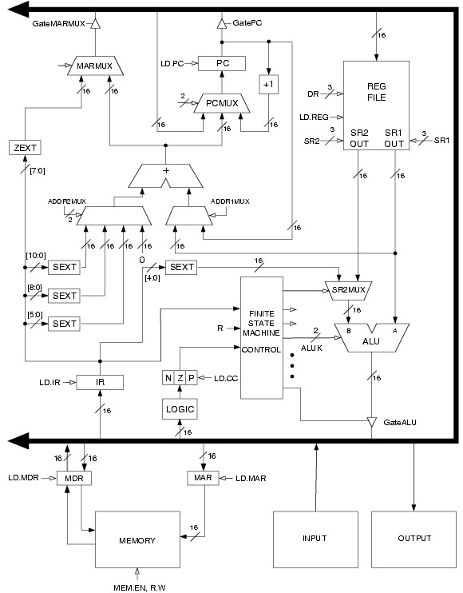
Summary: LC-3 Data Path
Filled arrow
= info to be processed.
Unfilled arrow
= control signal.

Slide 137
Summary: LC-3 Data Path
Control Unit
Processing
Unit
Filled arrow
= info to be processed.
Unfilled arrow
= control signal.
Memory
2018/10/25
137

Slide 138
Instruction Processing（state transtion）
F
Fetch instruction from memory
D
Decode instruction
EA
Evaluate address
OP
Fetch operands from memory
EX
Execute operation
S
Store result
Notes:
138

Slide 139
Data Path Components
Global bus
  special set of wires that carry a 16-bit signal to many components
  inputs to the bus are “tri-state devices,” that only place a signal on the bus when they are enabled
  only one (16-bit) signal should be enabled at any time
    control unit decides which signal “drives” the bus
  any number of components can read the bus
    register only captures bus data if it is write-enabled by the control unit
Memory
  Control and data registers for memory and I/O devices
  memory: MAR, MDR (also control signal for read/write)
Notes:
139

Slide 140
Data Path Components
ALU
  Accepts inputs from register file
  and from sign-extended bits from IR (immediate field).
  Output goes to bus.
    used by condition code logic, register file, memory
Register File
  Two read addresses (SR1, SR2), one write address (DR)
  Input from bus
    result of ALU operation or memory read
  Two 16-bit outputs
    used by ALU, PC, memory address
    data for store instructions passes through ALU
Notes:
140

Slide 141
Data Path Components
PC and PCMUX
  Three inputs to PC, controlled by PCMUX
    PC+1 – FETCH stage
    Address adder – BR, JMP
    bus – TRAP (discussed later)
MAR and MARMUX
  Two inputs to MAR, controlled by MARMUX
    Address adder – LD/ST, LDR/STR
    Zero-extended IR[7:0] -- TRAP (discussed later)
Notes:
141

Slide 142
Data Path Components
Condition Code Logic
  Looks at value on bus and generates N, Z, P signals
  Registers set only when control unit enables them (LD.CC)
    only certain instructions set the codes
    (ADD, AND, NOT, LD, LDI, LDR, LEA)
Control Unit – Finite State Machine
  On each machine cycle, changes control signals for next phase
  of instruction processing
    who drives the bus? (GatePC, GateALU, …)
    which registers are write enabled? (LD.IR, LD.REG, …)
    which operation should ALU perform? (ALUK)
    …
  Logic includes decoder for opcode, etc.
Notes:
142

Slide 143
Summary: ISA
High Level Language Program
temp = v[k];
v[k] = v[k+1];
v[k+1] = temp;
Compiler
Assembly Language Program
lw $15, 0($2)
lw $16, 4($2)
sw $16, 0($2)
sw $15, 4($2)
Assembler
0000 1001 1100 0110 1010 1111 0101 1000
1010 1111 0101 1000 0000 1001 1100 0110
1100 0110 1010 1111 0101 1000 0000 1001
0101 1000 0000 1001 1100 0110 1010 1111
Machine Language Program
Machine Interpretation
Control Signal Specification
ALUOP[0:3] <= InstReg[9:11] & MASK
°
°

Slide 144
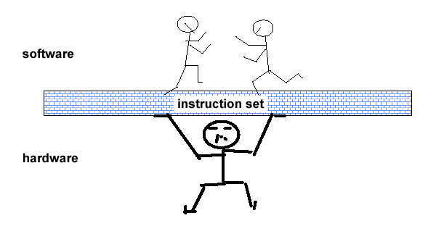
计算机体系结构定义:经典,狭义定义
... the attributes of a [computing] system as seen by the programmer, i.e. the conceptual structure and functional behavior, as distinct from the organization of the data flows and controls the logic design, and the physical implementation. – Amdahl, Blaaw, and Brooks, 1964

Slide 145
Instruction Set Architecture: 每个周期做什么事?
Stage1:从存储系统中获得指令
Instruction
Fetch
Stage2:确定做何动作
Instruction
Decode
Stage3:获得操作数
Operand
Fetch
Stage4:产生运算结果或状态
Execute
Stage5:向存储系统中存放运算结果
Result
Store
Stage6:确定下一条要执行的指令
Next
Instruction

Slide 146
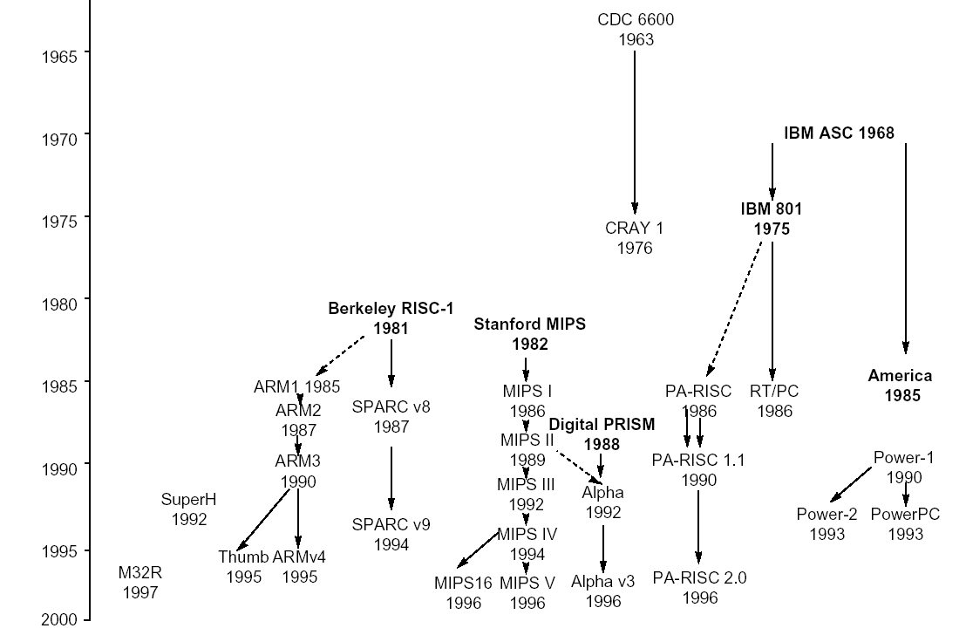
指令集的演化

